Slide 1
Copyright © 2020 CEMEX Innovation Holding Ltd., Switzerland, All Rights Reserved

Slide 2
ABOUT
THE GLOBAL R&D LABORATORY HAS THE MOST ADVANCED LABORATORY EQUIPMENT AND TESTS THAT ARE DESIGNED TO PROVIDE CROSS-DISCIPLINARY SOLUTIONS AND SUPPORT TO ALL OF OUR CORE BUSINESS
HIGHLY CREATIVE AND MULTIDISCIPLINARY GROUP OF SCIENTIFIC AND BUSINESS RESEARCHERS THAT ARE CHALLENGING THE TECHNICAL AND COMMERCIAL BOUNDARIES
OUR DYNAMIC NETWORK OF COLLABORATION WITH UNIVERSITIES AND REGIONAL EXPERTS ENABLE US TO SATISFY THE NEEDS OF OUR INDUSTRY
—LABORATORY SERVICES

Slide 3
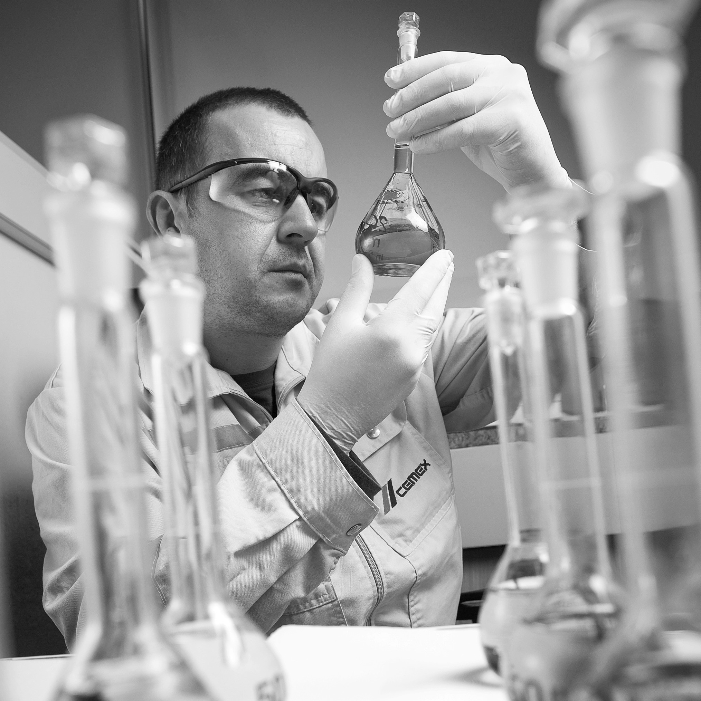
ACTIVITIES
STANDARD SERVICES
AND MATERIALS
EVALUATION
SPECIALIZED SUPORT
01
02
Services according to
European and American
Norms and internal procedures
Examples: SO3 Optimization, Burnability
Troubleshooting, resolving issues requiring specialized staff and advanced equipment
Examples: RCC Durability Study, Stain Issues Concrete
—LABORATORY SERVICES
04
03
R&D PROJECTS
COLLABORATION
Research and Development Projects
With Universities/ Technical centers

Slide 4
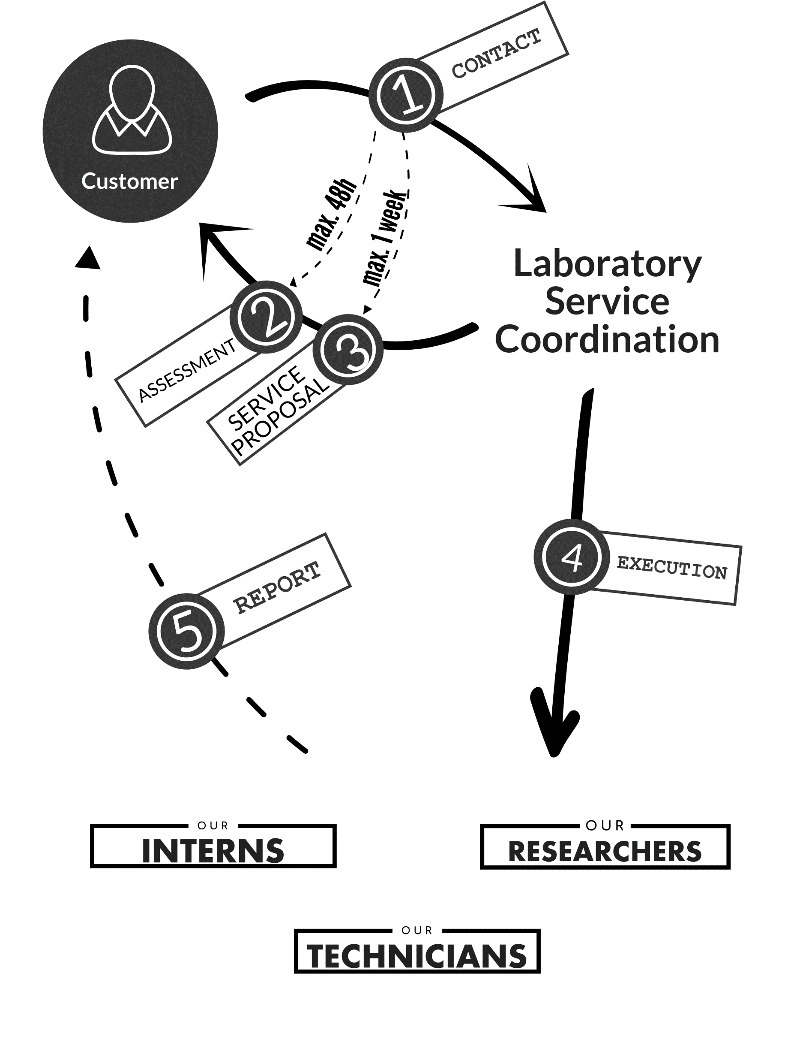
LABORATORY SERVICES
Services are a part of the Global R&D area that is dedicated to provide specialized technical support to different areas of the company.
All business units' costumers make a Service Request and the Laboratory Staff assess to provide with the proposal and expected delivery of the results.
—LABORATORY SERVICES

Slide 5
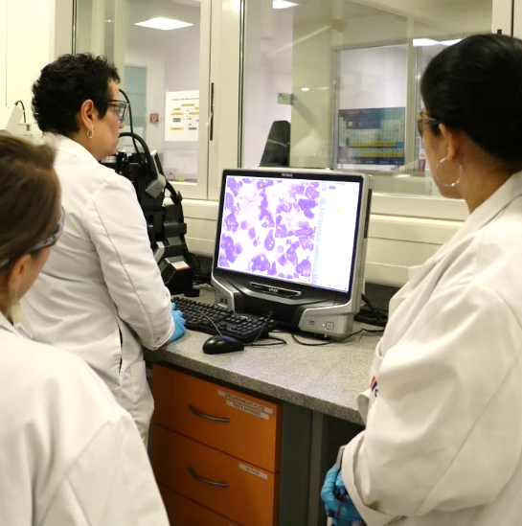
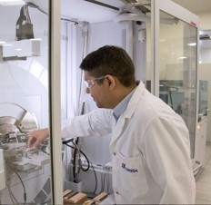
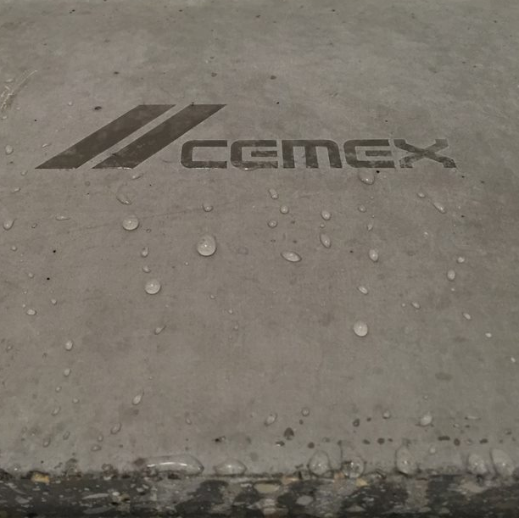
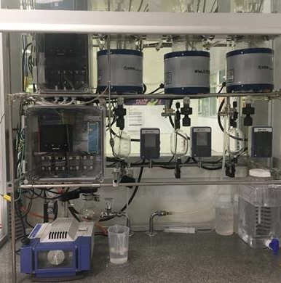
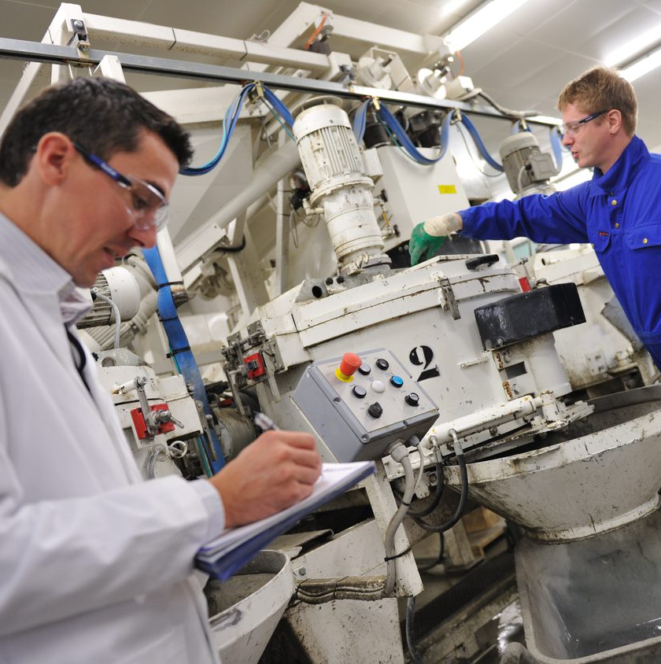
MANIFESTO
(OUR PROMISE)
We will provide our customers the best solutions for their needs with the highest standards of quality and in a timely manner.
We join forces, in terms of expertise and equipment, with our internal and external network to consistently deliver high-quality solutions for our customers.
We guarantee a response to any customer inquiry, question or complaint within 48 hours from receipt and a follow-up within a week.
We assure our customers that updates on the status of their requests will be provided as agreed. We commit to closing our customer’s request at the established time, providing reports and certificates that endorse the finalization of the service.
We strive to achieve the highest Customer Satisfaction
—LABORATORY SERVICES

Slide 6
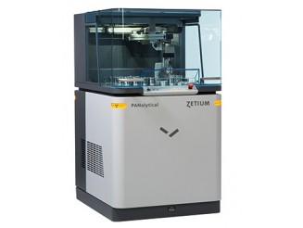
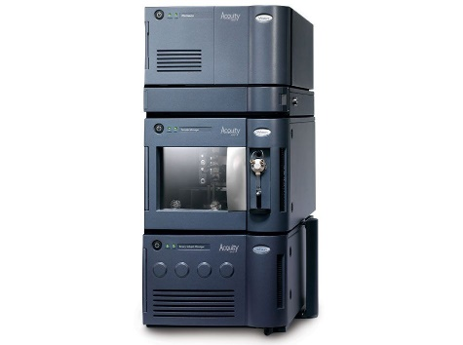
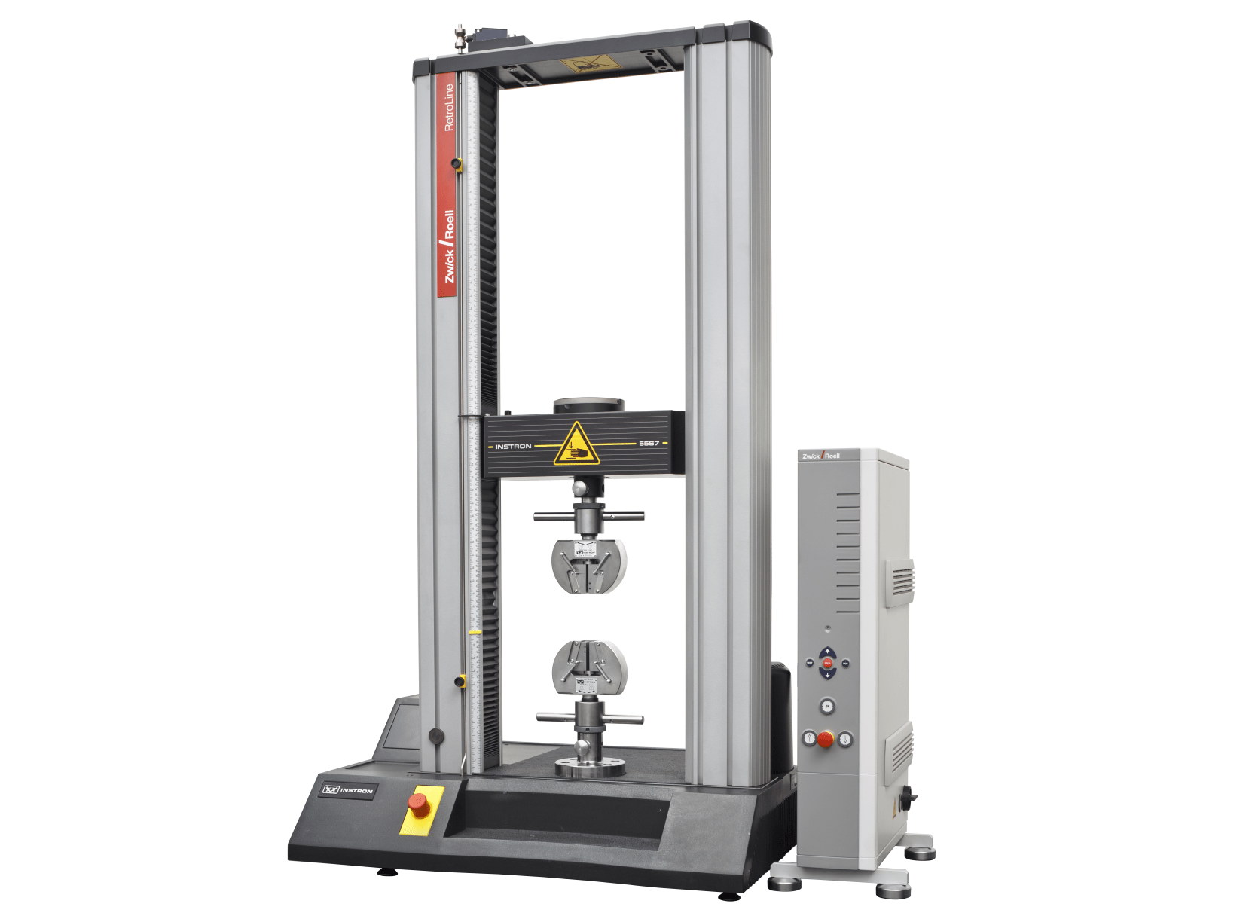
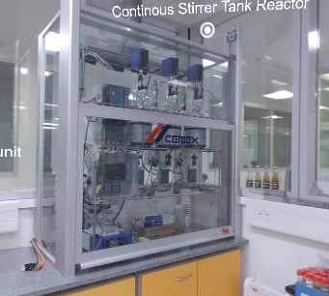
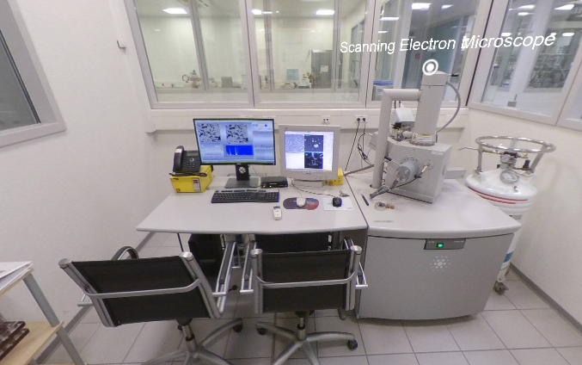
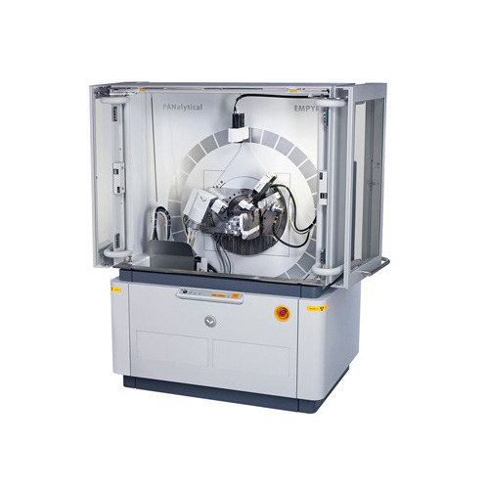



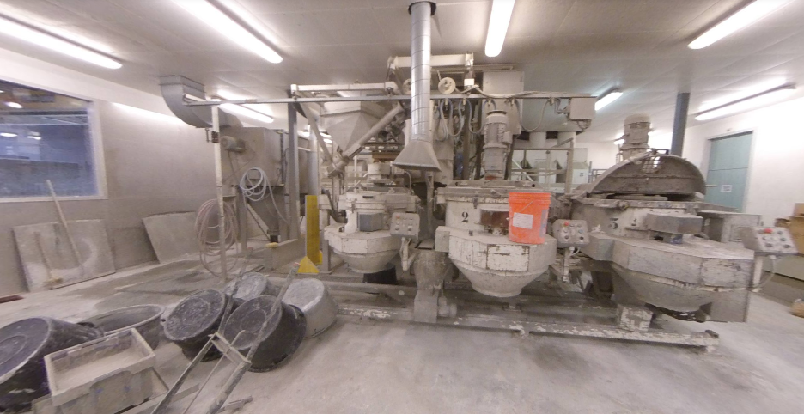
SPECIALIZED SUPPORT
X-Ray Fluorescence
Ultra Performance Liquid Chromatography
Universal Testing Machine
Continous Stirrer Tank Reactor
Environmental SEM
—LABORATORY SERVICES
OPTICAL MICROSCOPY & SEM
INORGANIC AND MATERIALS SCIENCE
ORGANIC ANALYTICS
CONCRETE
SYNTHESIS
X-Ray Diffraction
Infrared Spectroscopy (FTIR)
Batching and Mixing
Plant IMER
Moisture Analyzer
Optical Digital Microscope

Slide 7
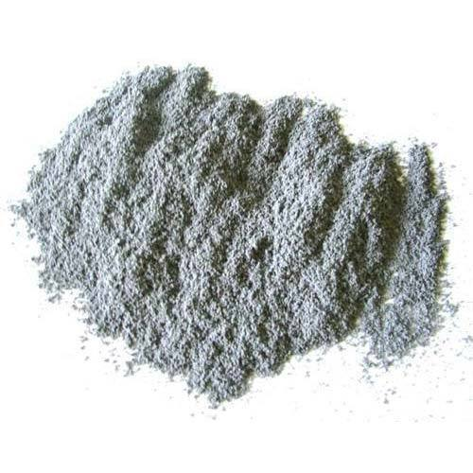
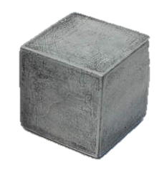
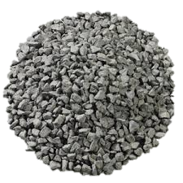

STANDARS SERVICES
CEMENT
CONCRETE
AGGREGATES
ADMIXTURES
Liquid state
  Workability
  Consistency
Hardened State
  Mechanical testing
  Durability
  Thermal testing
  Chemical
  Microscopy and SEM
Pilot concrete testing and customized pieces
  IMER and CNC
Physical Testing
  ASTM C150
  EN 196
  Rheology
  Particle Size Distribution
Chemical Testing
  Chloride Determination
  Alkalis Analysis
  Characterization
  Mineralogical Analysis
Process Services
  Ball Mill
  Alternative Fuels
  Burnability
Soil
  Plasticity Index
  Alkali-Silica Reaction
  Size Distribution
  Density
  Crushing tensile Tests
  Crushing Value
  Particles Hardness
  Gauge Length, Shape & Thickness
  Los Angeles Coefficient
  Jigging Machine
  Micro Deval Coefficient
  Los Alamos Test
  Blue Methylene Test
  Leaching Test
  Flexiness Index
  Freeze and Thaw
Deformulation
Structural Elucidation: polymers
Plasticizers, accelerators, retarders, VMAs testing
Hydrophobic Admixtures: air entrainers, curing agents, waterproofing
PCE synthesis
Griding Aids Testing
Formulation
—CAPABILITIES & EXPERTISE

Slide 8
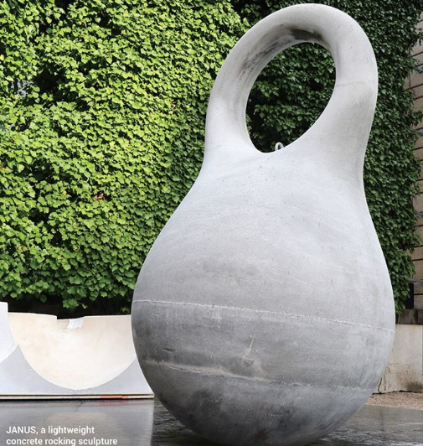

STANDARS SERVICES
Physical Testing
CONCRETE
CEMENT
  ASTM C150
  EN 196
  Rheology
  Particle Size Distribution
01
Liquid state
Chemical Testing
  Workability
  Consistency
01
  Chloride Determination
  Alkalis Analysis
  Characterization
  Mineralogical Analysis
02
—CAPABILITIES & EXPERTISE
Hardened state
  Mechanical testing
  Durability
  Thermal testing
  Chemical
  Microscopy and SEM
02
Process Services
13 RESEARCHERS SPECIALIZED IN THIS CATEGORY
8 RESEARCHERS SPECIALIZED IN THIS CATEGORY
  Ball Mill
  Alternative Fuels
  Burnability
03
Pilot concrete testing and customized pieces
Soil
  IMER and CNC
03
04
  Plasticity Index

Slide 9

STANDARS SERVICES
AGGREGATES
ADMIXTURES
Mechanical testing
Deformulation
01
01
—CAPABILITIES & EXPERTISE
Geometry testing
Structural Elucidation: polymers
02
02
Hydrophobic Admixtures: air entrainers, curing agents, waterproofing
2
RESEARCHERS SPECIALIZED IN THIS CATEGORY
5 RESEARCHERS SPECIALIZED IN THIS CATEGORY
Waste benefitiation projects
03
03
Chemical testing
PCE synthesis
04
04

Slide 10


CONTACT US
WHEN:
IN DOUBT
NEED ASSISTANCE
NEED GUIDANCE
NEED A SOLUTION
NEED AN ENGINEERING SUPPORT
GIVE US A CALL:
Office : +41(32366)7857, Mobile:+41794643506
OR WRITE:
javier.cruzc@cemex.com
—CONTACT INFORMATION

Slide 11
Copyright © 2020 CEMEX Innovation Holding Ltd., Switzerland, All Rights Reserved

