Slide 1
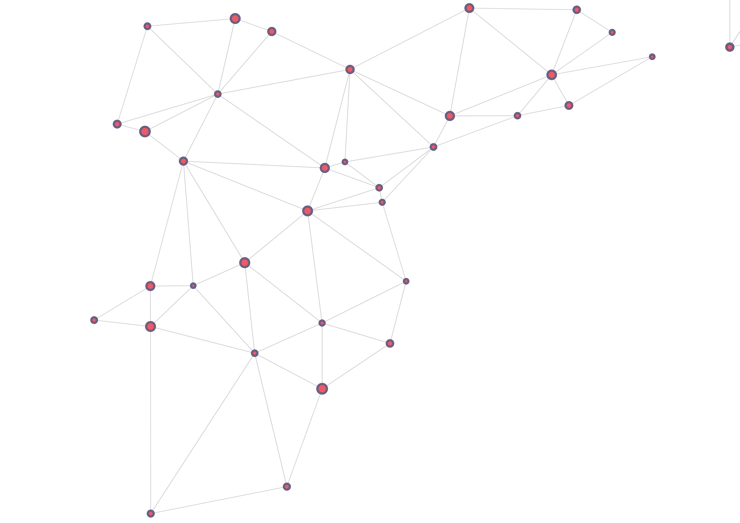






DISCOVER WHAT WE HAVE TO OFFER FOR YOUR NEXT
BIM PROJECT
CEMEX has acknowledged the wave of digital transformation in the AEC (Architectural, Engineering and Construction) Industry through BIM (Building Information Modeling). BIM is considered the centerpiece of the construction industry’s digital transformation and it is becoming part of our customer working environment.
This new methodology relies in 3D modeling coupled with data management across the construction project supply-chain and lifecycle. CEMEX has released proprietary digital tools for different application fields, to enhance customers experience with our products and construction solutions in the BIM environment.
Building Information Modeling
Fiber reinforced concrete of
ultra-high performance that can
replace steel reinforcement in concrete.
Rapid Hardening concrete that allows workability for up to 90 minutes.
Contact details
p: 032 366 78 00
e: abc@cemex.com
a: adress
100% Ready Mix Concrete solution for Thermal Insulation, it eliminates thermal bridges thus.
www.cemex.ae
Copyright © 2020 CEMEX Trademarks Holding Ltd. All rights reserved.

Slide 2



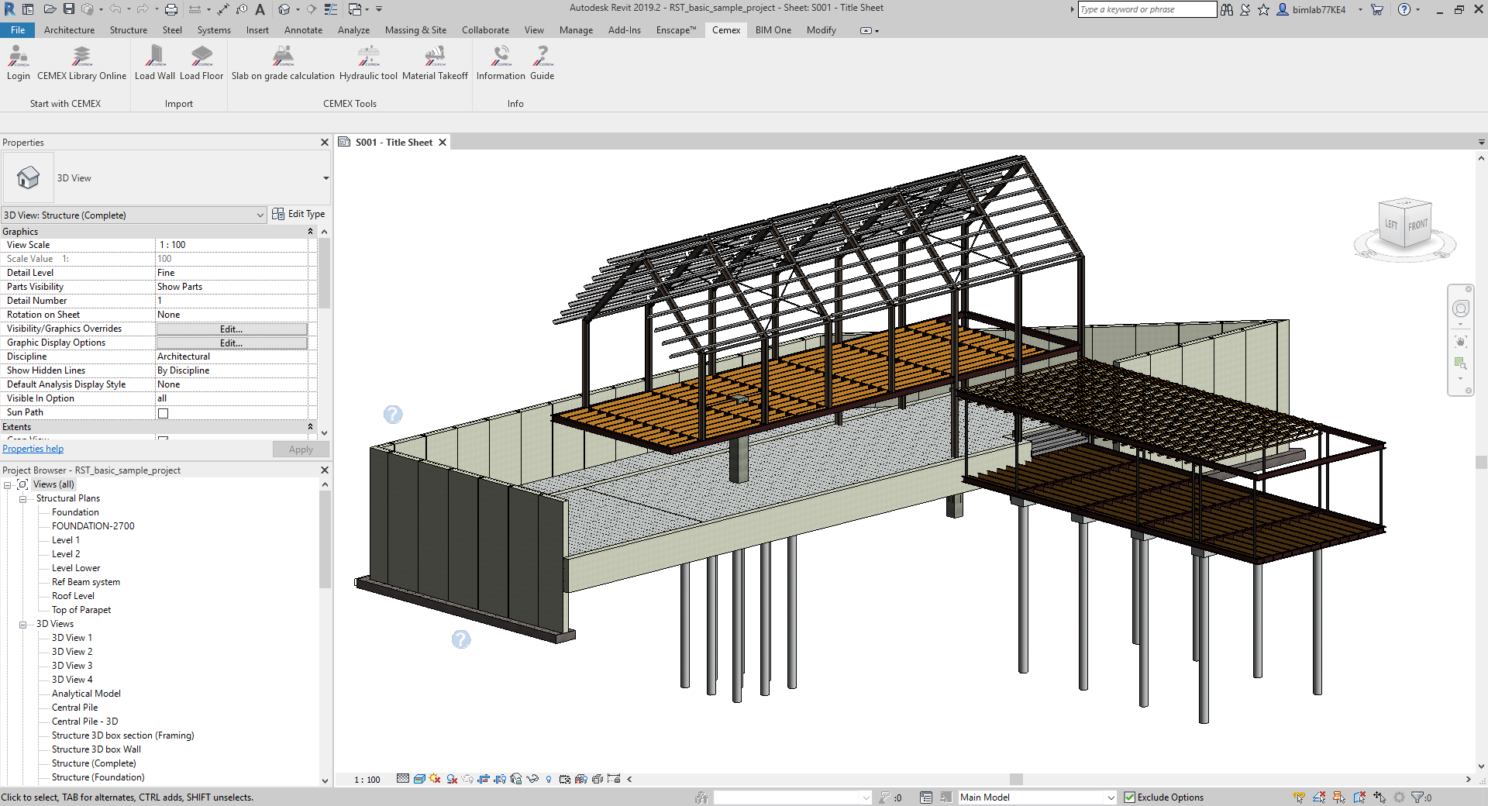
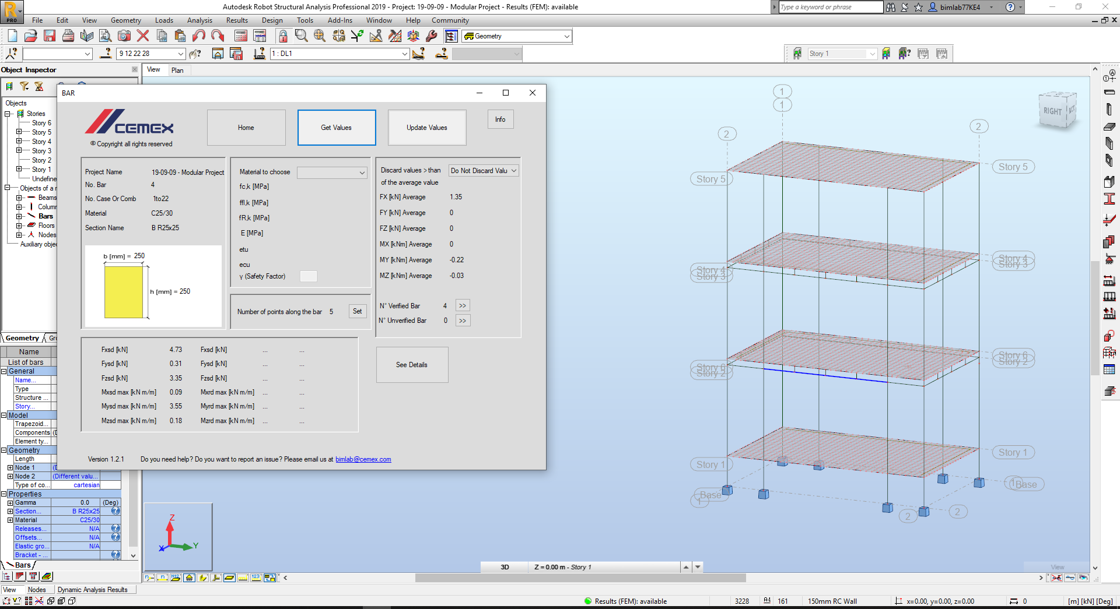
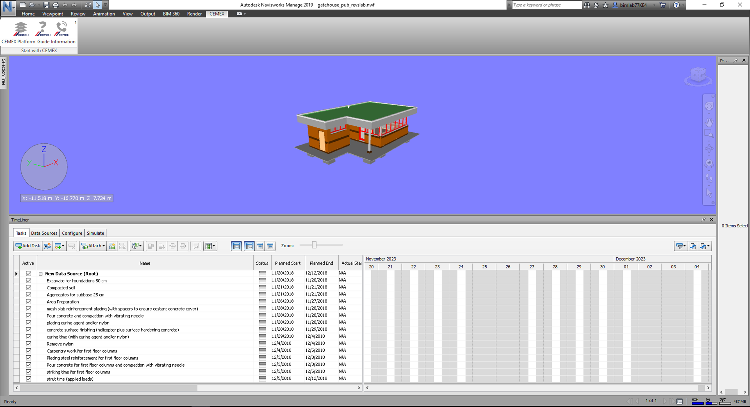
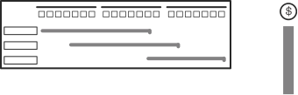


Cemex tool
Cemex tool
Cemex tool
for
for
for
IMPORT THE SOLICITATION VALUES
FROM YOUR STRUCTURAL SOFTWARE
TO CEMEX ADD-ON
SPECIFY THE PHYSICAL
AND STRUCTURAL NEEDS OF YOUR PROJECT
ON THE GANTT CHART OF YOUR PROJECT
SELECT THE TYPE OF
FIBER-REINFORCED CONCRETE
YOU WANT TO APPLY TO
RUN THE CALCULATIONS
RUN CEMEX’S SPECIAL PLUG-IN TO GENERATE A UNIQUE AND CUSTOMISED SOLUTION
SPECIFY YOUR CONCRETE-
RELATED TASKS USING
CEMEX’S VALUE-ADDED PRODUCTS
AND HAVE YOUR CEMEX OBJECT
IN YOUR REVIT LIBRARY
READY TO BE ADDED TO
YOUR PROJECT
CEMEX’s Value-Added Products provide self-leveling, self-curing, rapid hardening and other unique performances to optimize tasks during construction.
is CEMEX’s fiber-reinforced concrete of ultra-high performance to replace steel reinforcement in concrete structures.
AND HAVE AUTOMATICALLY REFLECTED ON YOUR TIMELINE THE SAVINGS GENERATED BY CEMEX PRODUCTS
WOOD
CEMEX’s Objects provide performance-based information that can be used to run Multiphysics analysis such as structural, thermal efficiency and acoustic performance.
GLASS
AND HAVE VISIBILITY OF ALL THE VALUES AND DIAGRAMS WITH THE POSSIBILITY TO PRINT A COMPLETE REPORT
CEMEX OBJECT

