Slide 2

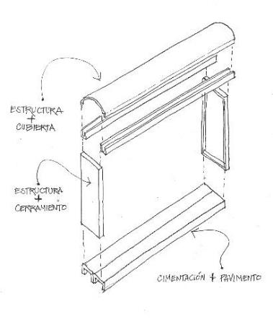
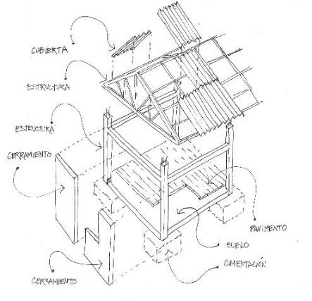
THE PAST OF ARCHITECTURE
THE FUTURE OF ARCHITECTURE
-Evolution of the construction
Structure = Wall = Finishes
❶ = ① + ② + ③
① Structure + ② Walls + ③ Finishes

Slide 3
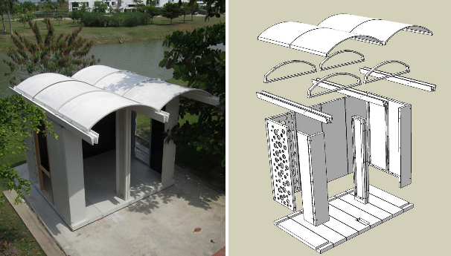
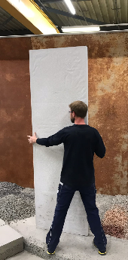
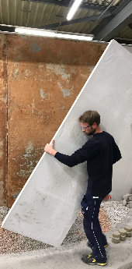
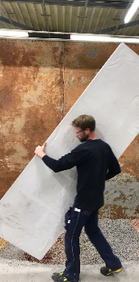
PREFABRICATED MODULAR SOLUTION
  LIGHT WEIGHT AND HIGH CONCRETE STRENGTH
Easy to assemble manually
Easy to transport
-System DOMUS

Slide 4




WHO ARE THE TARGETED CUSTOMERS?
Architects and engineers, builders/ developers (e.g. low-income housing), governments, emergency shelters
technology has enabled more cost-effective production (e.g. concrete folding to produce roof), small production footprint, and more efficient transportation, and therefore can offer very economical-high quality solution that can be mass-customized.
WHAT IS THE NOVELTY?
-R&D approach – Value proposition
WHAT ARE THE POTENTIAL BENEFITS?
Unique modular and cost-effective* system made of Resilia technology that can be easily handled and assembled by only 2 workers rapidly.
* Domus 40m² unit: GFRC- 29 000USD vs. Resilia LW- 18 000 USD

Slide 5
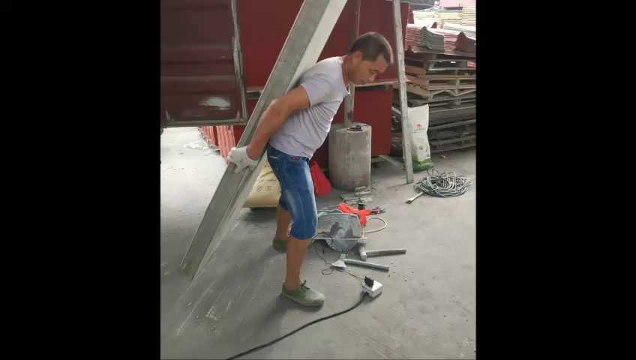
Precast, modular, lightweight cement-base solution to compete against current offer on the market (e.g. metal container, wood panels, aluminum panels) – trends Confirmed by CX Ventures.
Technical & Economic viability driven by CX Concrete Solution:
high-strength + high ductility + lightweight + aesthetics.
Interest of Corporate Social Responsibility to implement Domus solution in CEMEX Spain (Alcanar) or low-income housing in MEXICO.

Slide 6




The world evolves towards the lightweight construction and more environmentally friendly buildings.
The use novel materials that use fewer raw materials and offer better performance at the same time is a constant requirement in 21st century architecture.
The 100% manufactured DoMuS system with . represents a comprehensive solution that responds to the challenges that the market and today's society pose to architects and builders.

Slide 7



In the current environmental situation we are witnessing the re-foundation of the principles of efficiency in construction based on respect for the natural environment.
Our response to the new social demands must go through the awareness that only as we reduce the use of raw materials and energy can we preserve the planet for the future.
The DoMuS system is based on principles of sustainability, social awareness, ecological responsibility and efficient use of materials and techniques

Slide 8
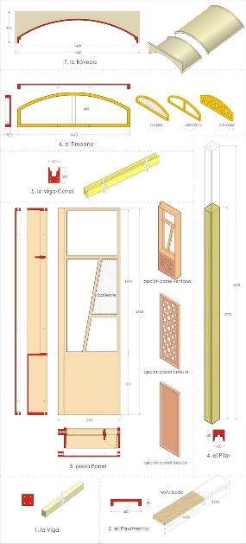
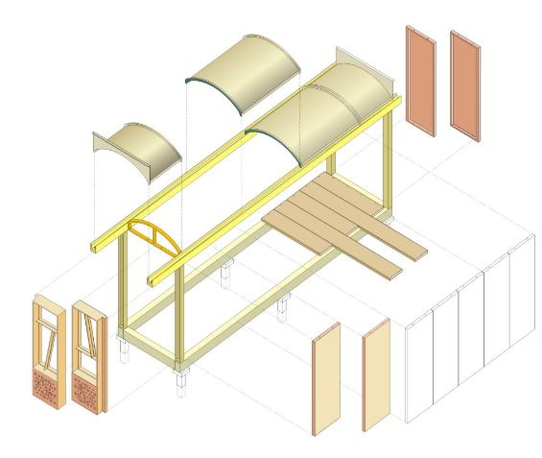
-Assembly system

Slide 9
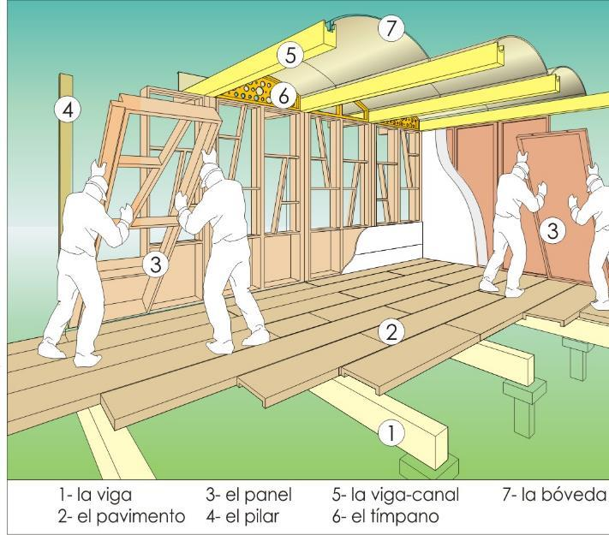
-Manual and expert mounting

Slide 10
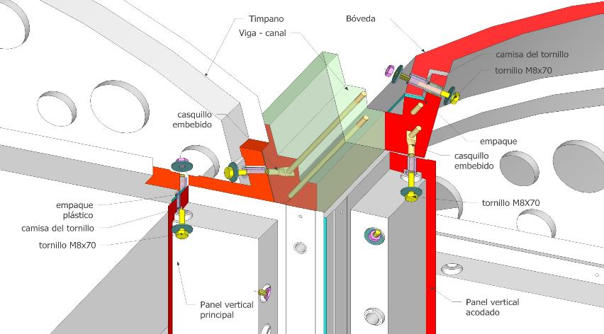
- Mechanized system for dry packaging

Slide 11
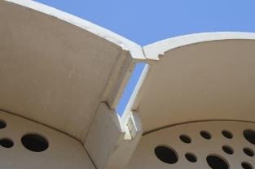
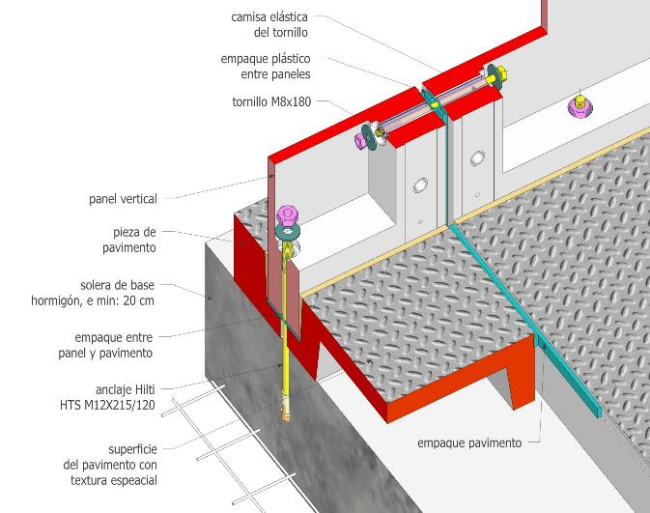
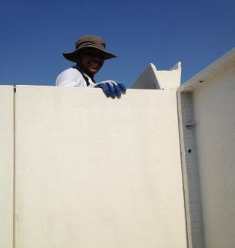
-It does not require water in its construction

Slide 12
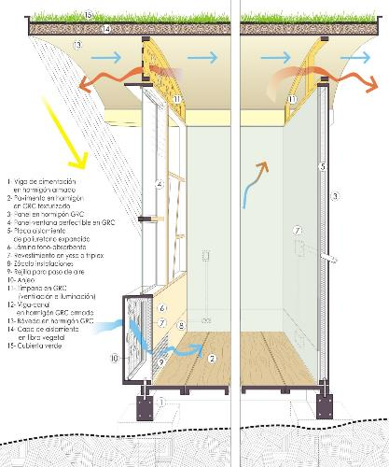
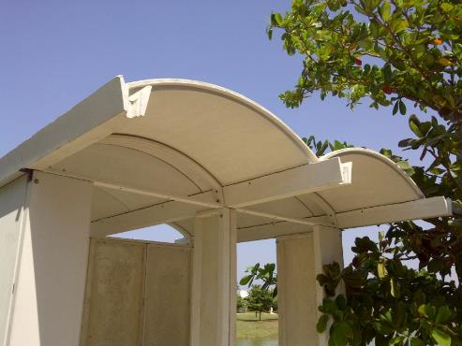
- Adaptation to the environment

Slide 13
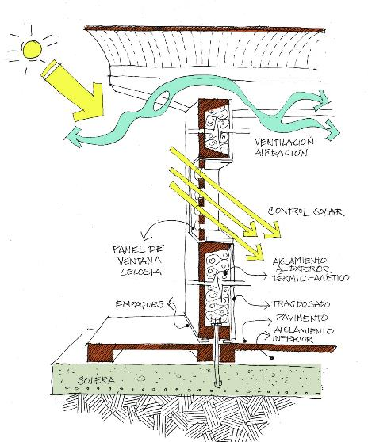
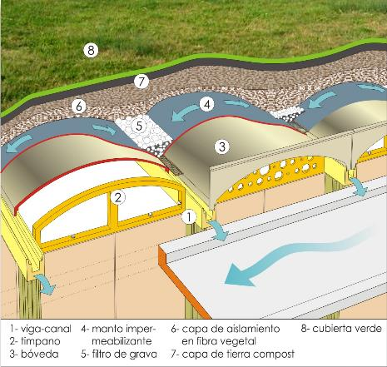
-Bioclimatic architecture

Slide 14
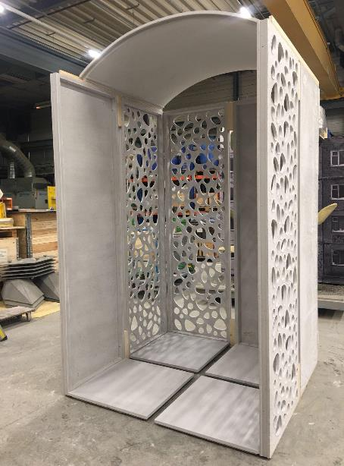
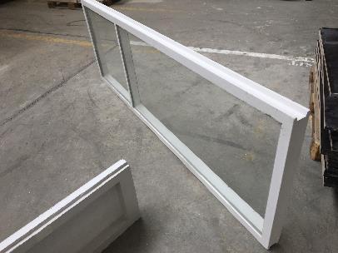
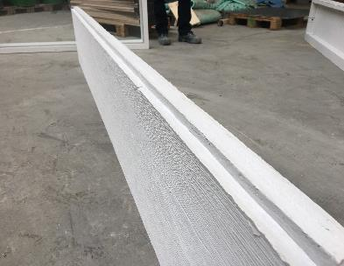
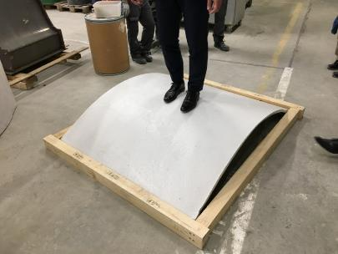
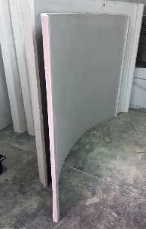
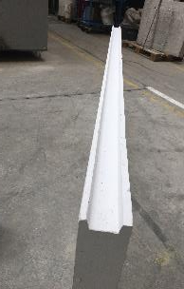

Slide 15

= less is more
lower volume = low production cost
lower energy consumption = low CO₂ emission
lower weight = low transport cost
dry work = less ecological footprint
no rubble = less environmental impact
manual mounting = no heavy mounting means
no steel rebar reinforcement = easy recycling
designed for disassembly = possible change of location
higher flexural tensile strength = earthquake resistance

Slide 16
DoMuS SYSTEM
LOW INCOME HOUSING APPLICATION
Project for a of 40 m² house

Slide 17
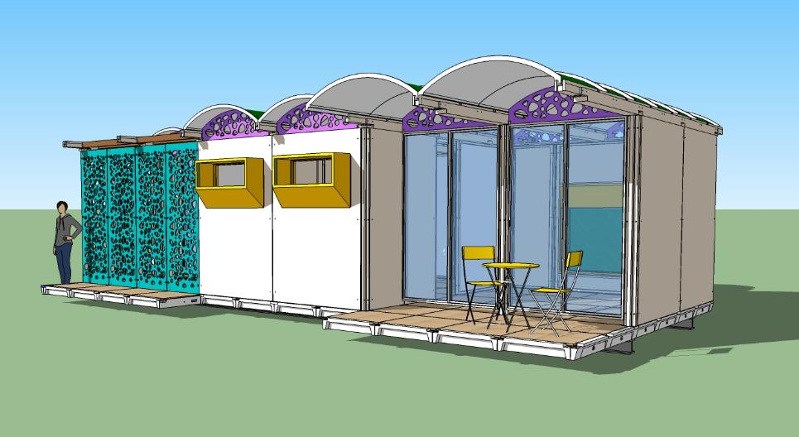
entrance view
House 40 m²

Slide 18
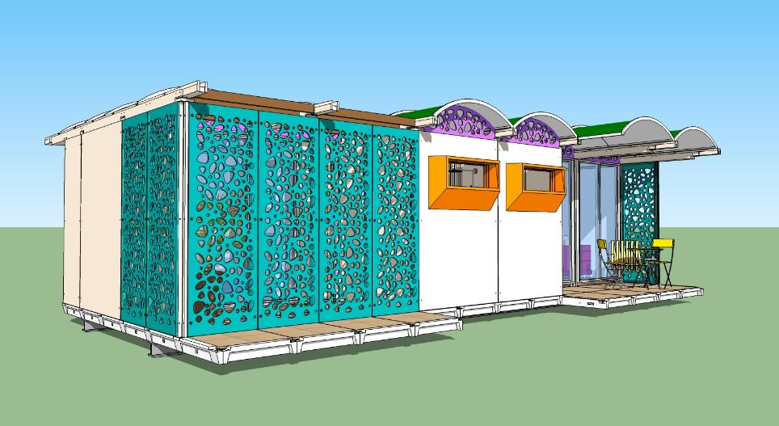
entrance view
House 40 m²

Slide 19
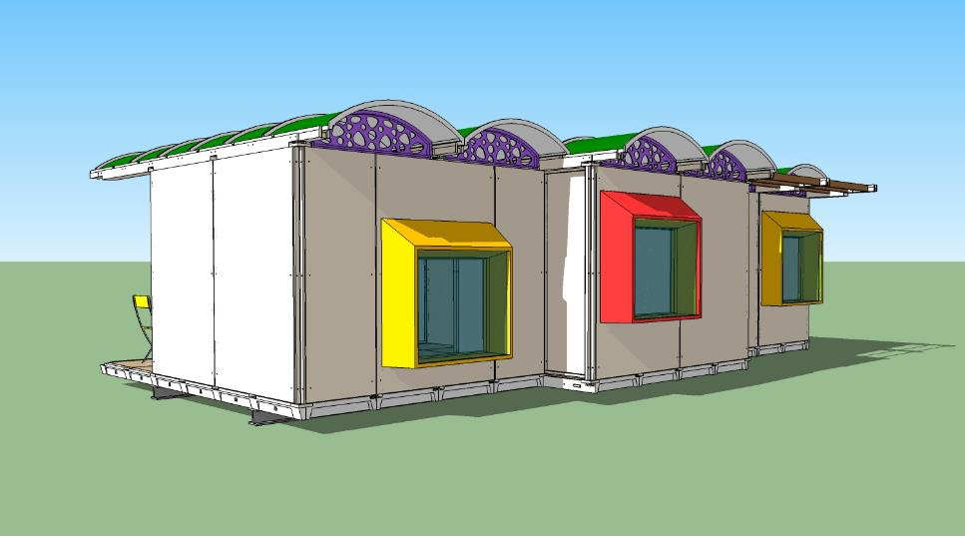
side view
CASA 40 m²

Slide 20
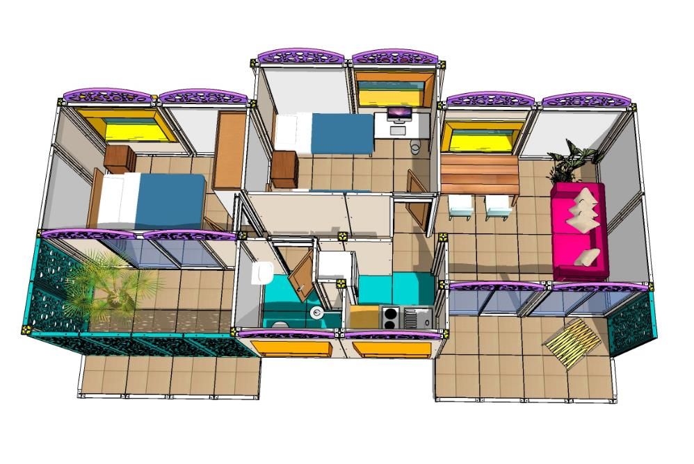
Top view
House 40 m²

Slide 21
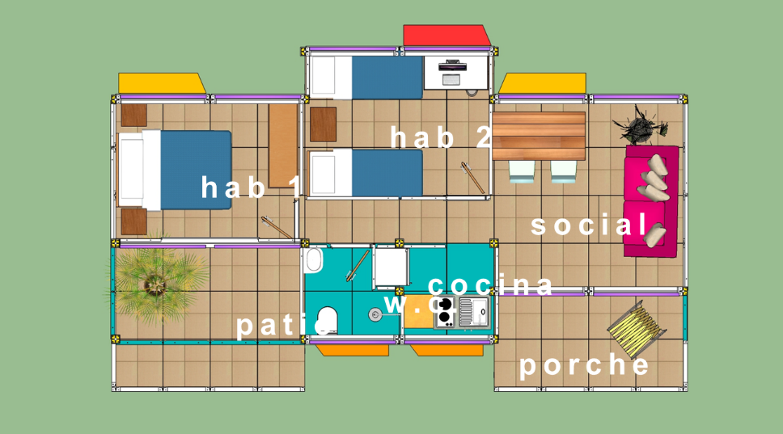
Plan view
House 40 m²

Slide 22
Agility
Assembly speed
by screw unions.
Localized
Manual assembly and without
previous technical experience.
Low environmental impact
No waste or trash on site.
Sustainability
Low consumption of raw materials
and energy.
Ecology
Construction system
without water.
Durability
Use of high-performance concrete.

Slide 23
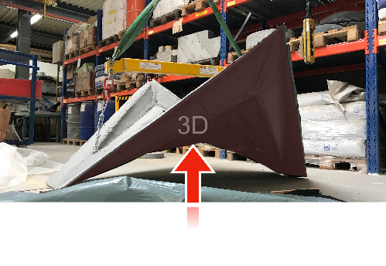
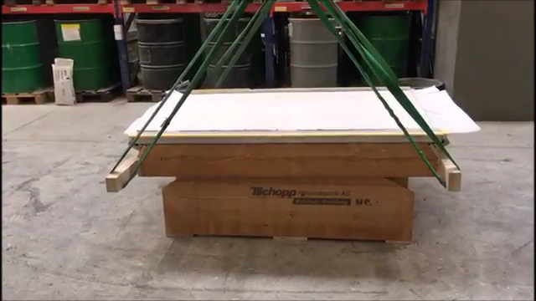
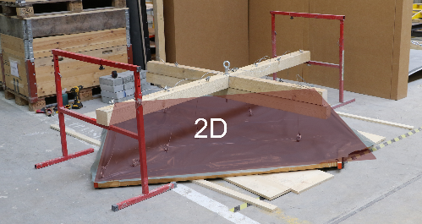
-Resilia Folding technics
2D

Slide 24
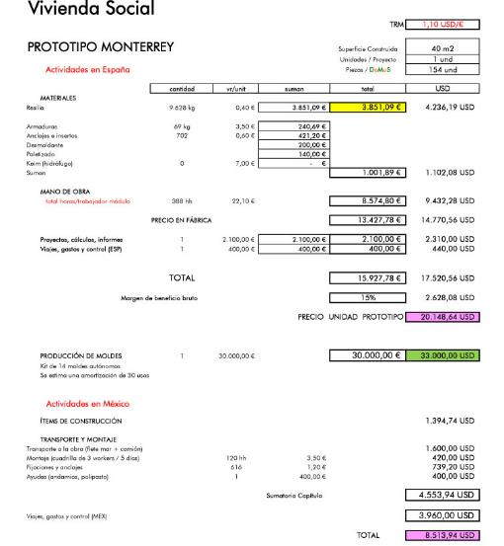
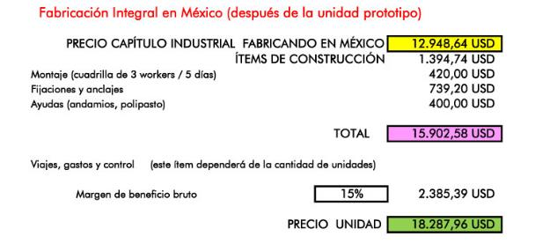
The costs of the post-prototype units may be revised downwards based on the characteristics of each project (quantities, conditions of the plot, program of each dwelling, etc.

Slide 25
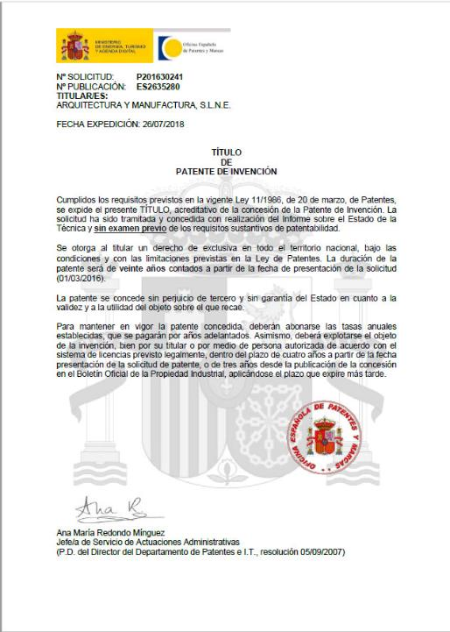
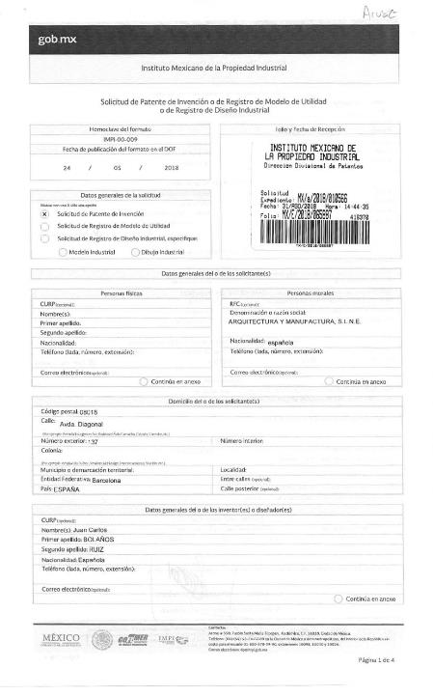
-Patented system – SPAIN/MEXICO

