Slide 1
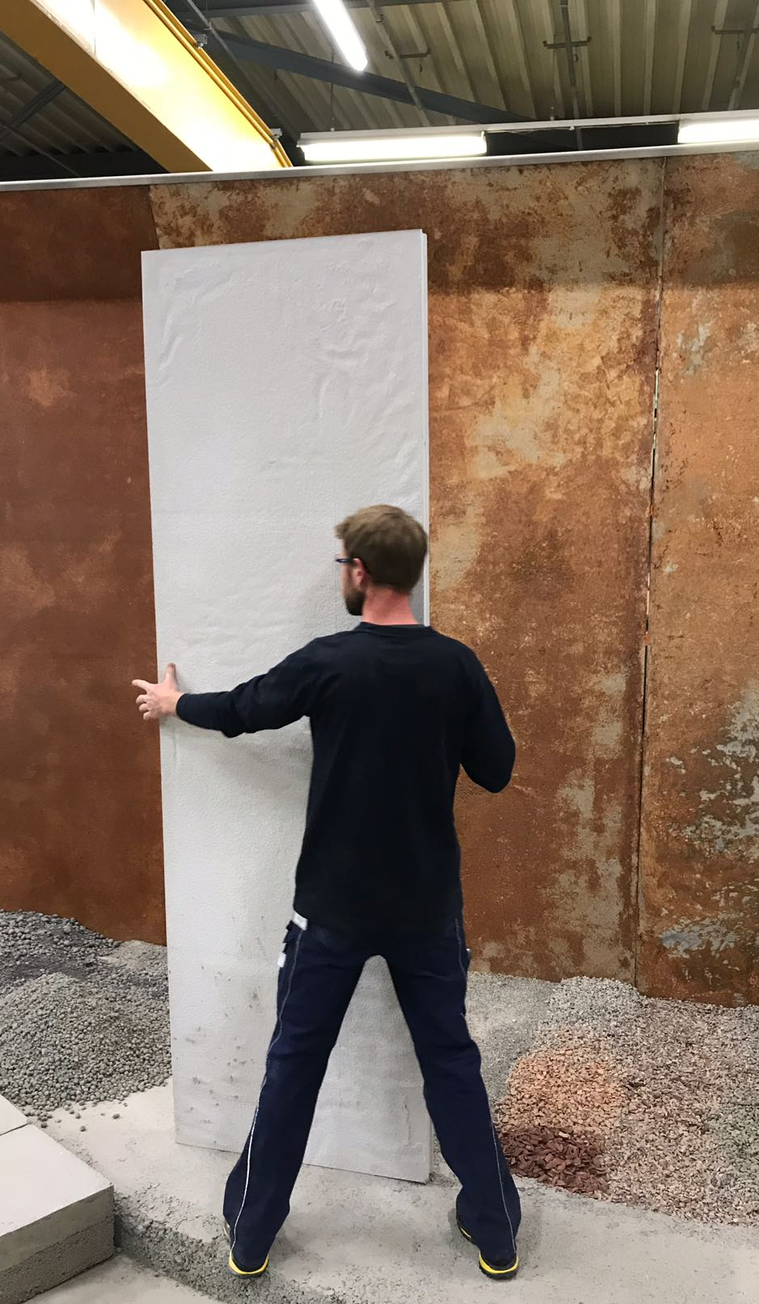
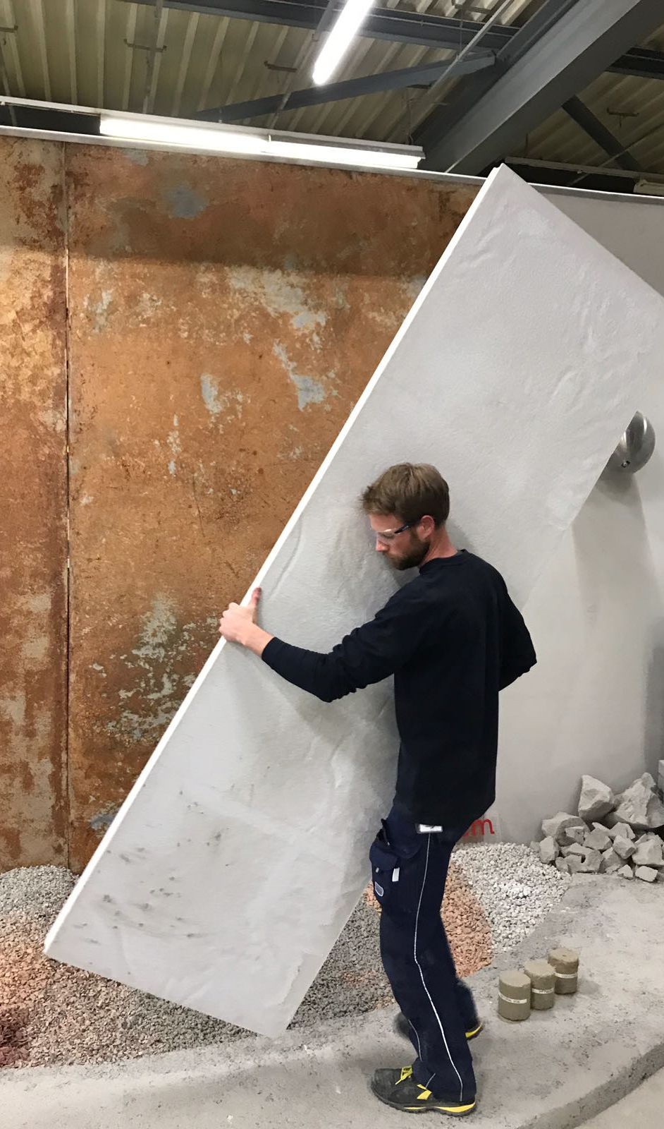
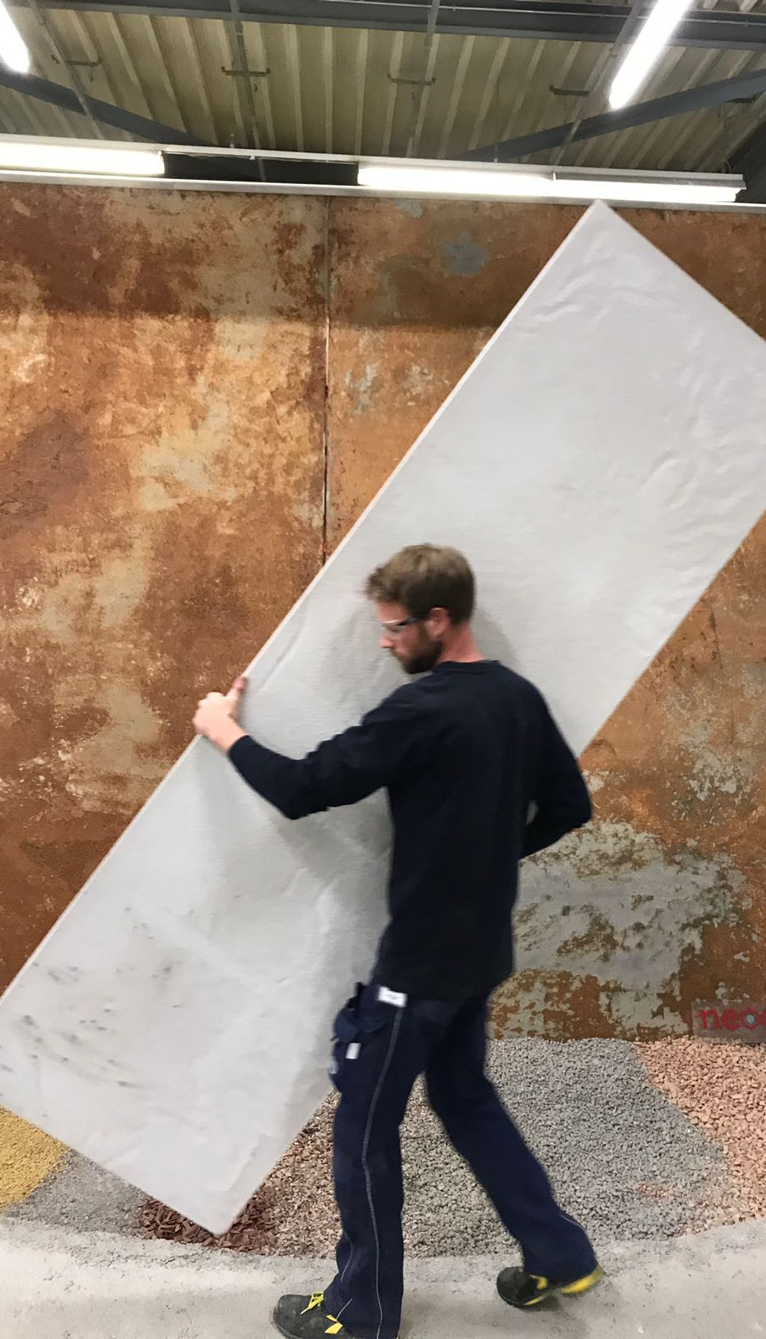
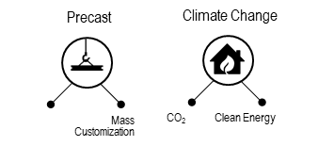
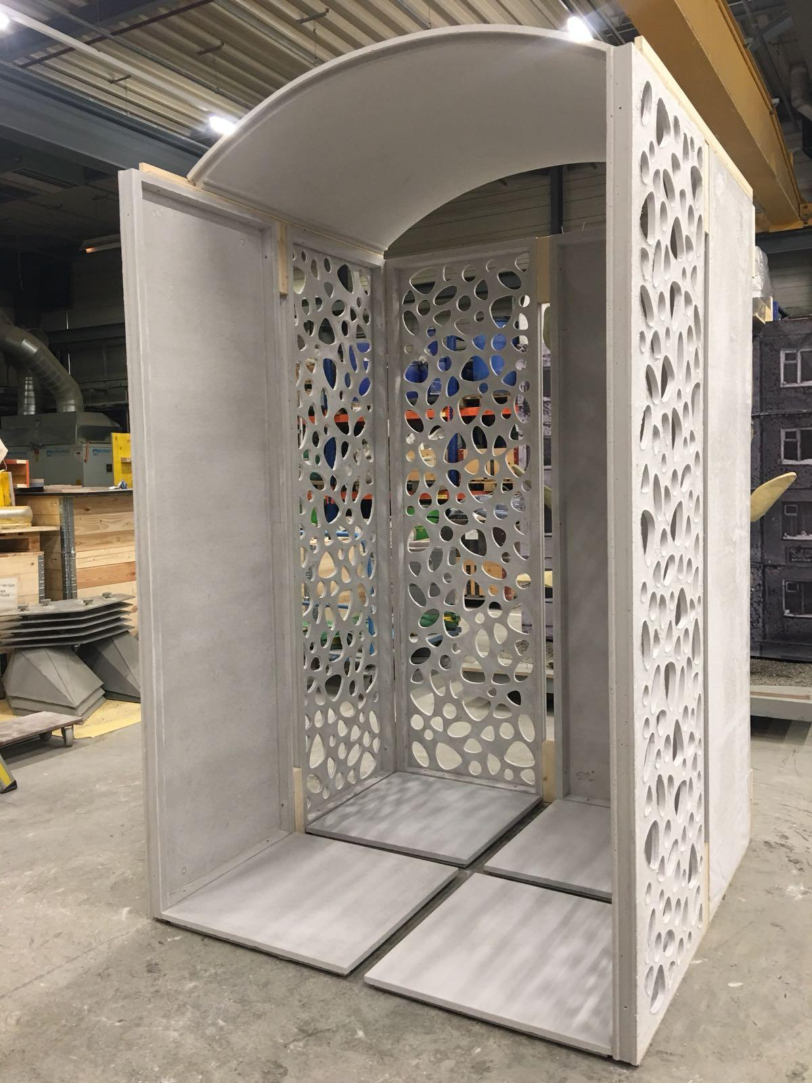
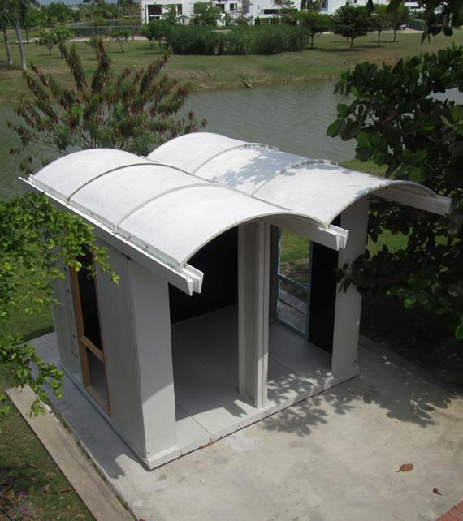
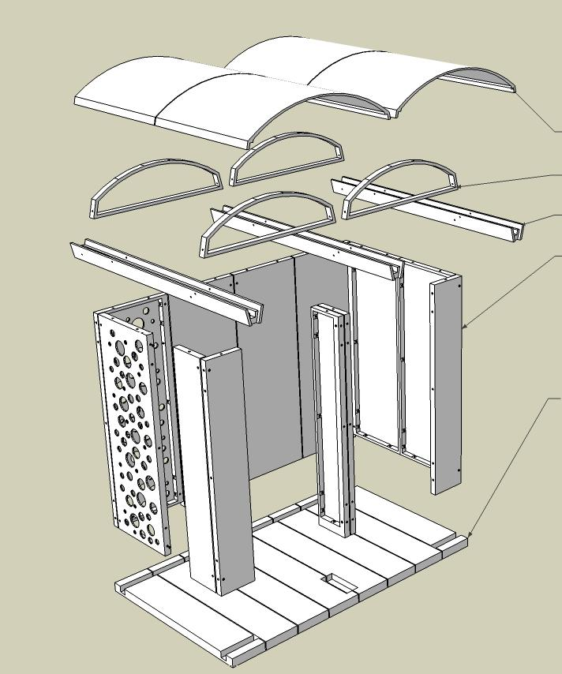

DOMUS System
TECHNOLOGY
Modular Lightweight Construction offering a competitive alternative against wood & steel.
VALUE PROPOSITION
Unique modular system made of concrete that can be easily handled and assembled by only 2 workers rapidly.
CUSTOMER PROFILS
  Architects
  Engineers
  Builders
  Developers
APPLICATIONS
  low income housing governments,
  emergency shelters
Lightweight

