Slide 1
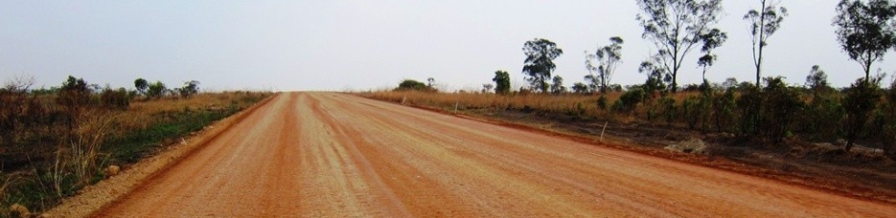

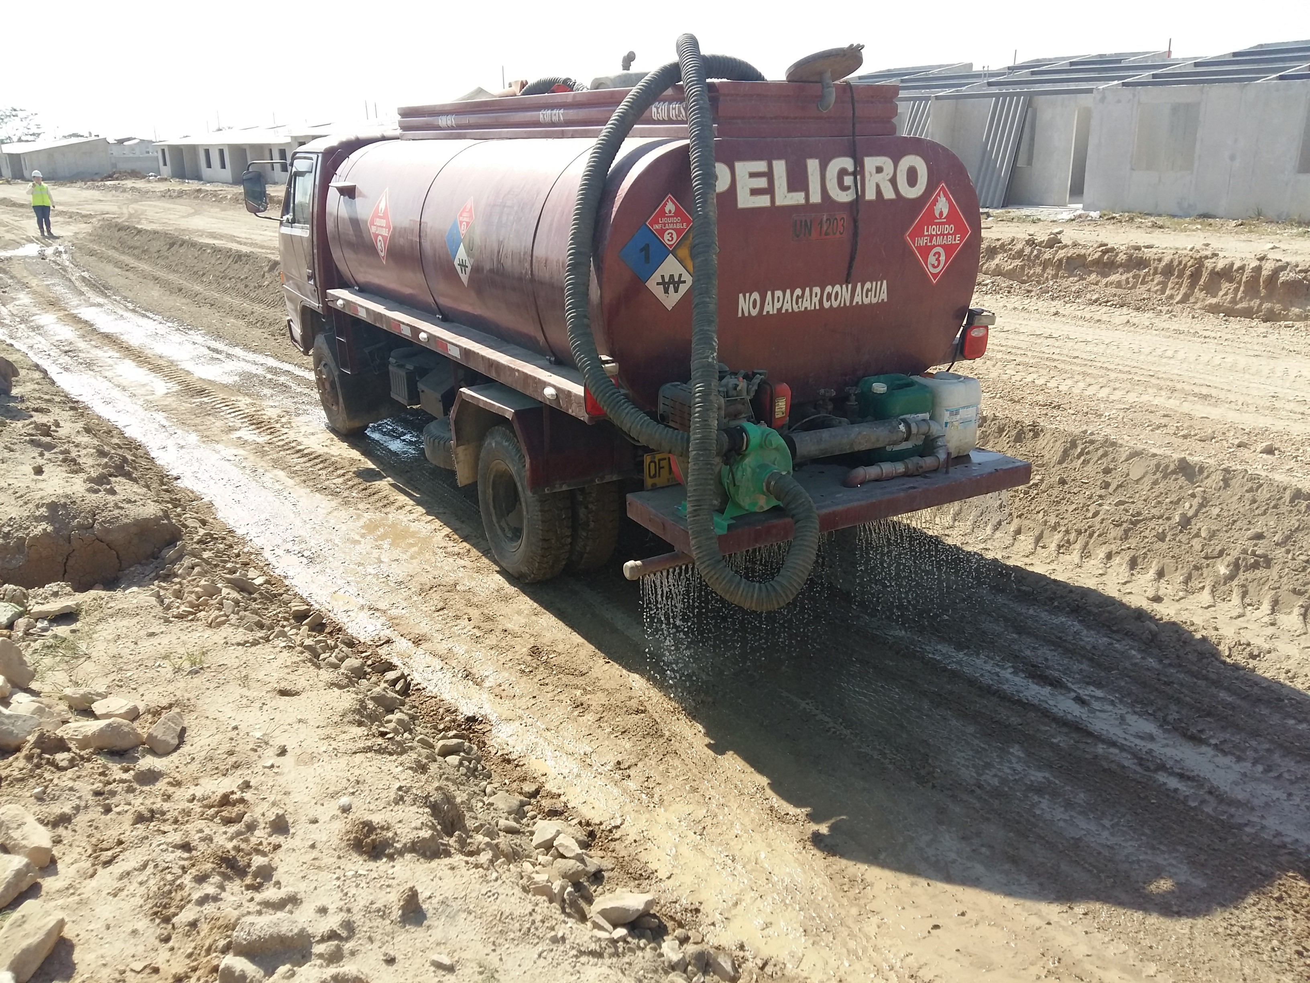
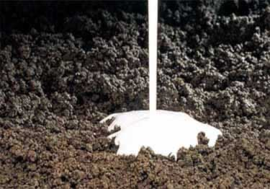
Soil Stabilization Admixtures
Specific range of admixtures for the stabilization of soil and the production of pavements.
CHARACTERISTICS
Products designed to be combined with soil, in order to provide with an hardening effect, and to improve the compaction.
Will also give the surface a water-repellent behavior to increase the durability of the pavement
Product is sprayed and mixed with the soil before compaction.
VALUE PROPOSITION
  Easy to use: diluted and sprayed on the soil
  Robust: works with most of soil types
  Eco-friendly products
  Enables to production of pavements in rural areas
TECHNOLOGY
ISOVIA 7 series

