Slide 1
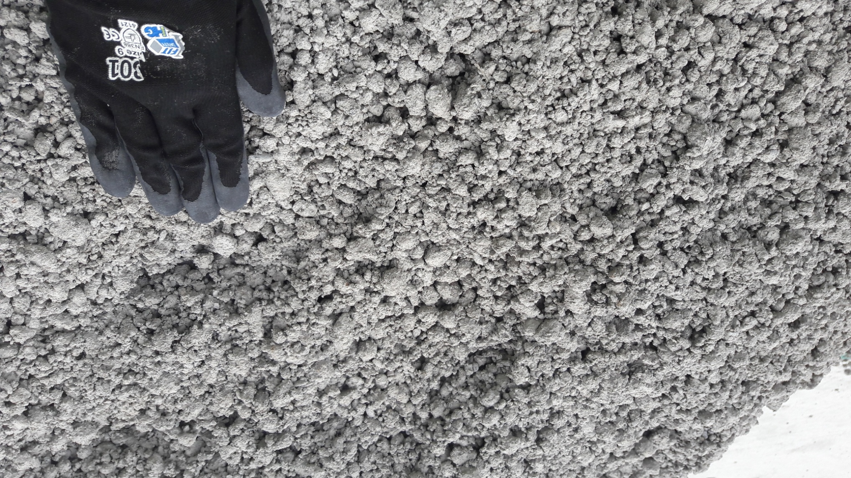

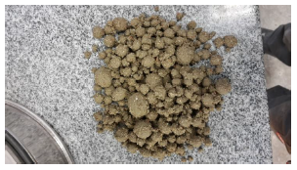
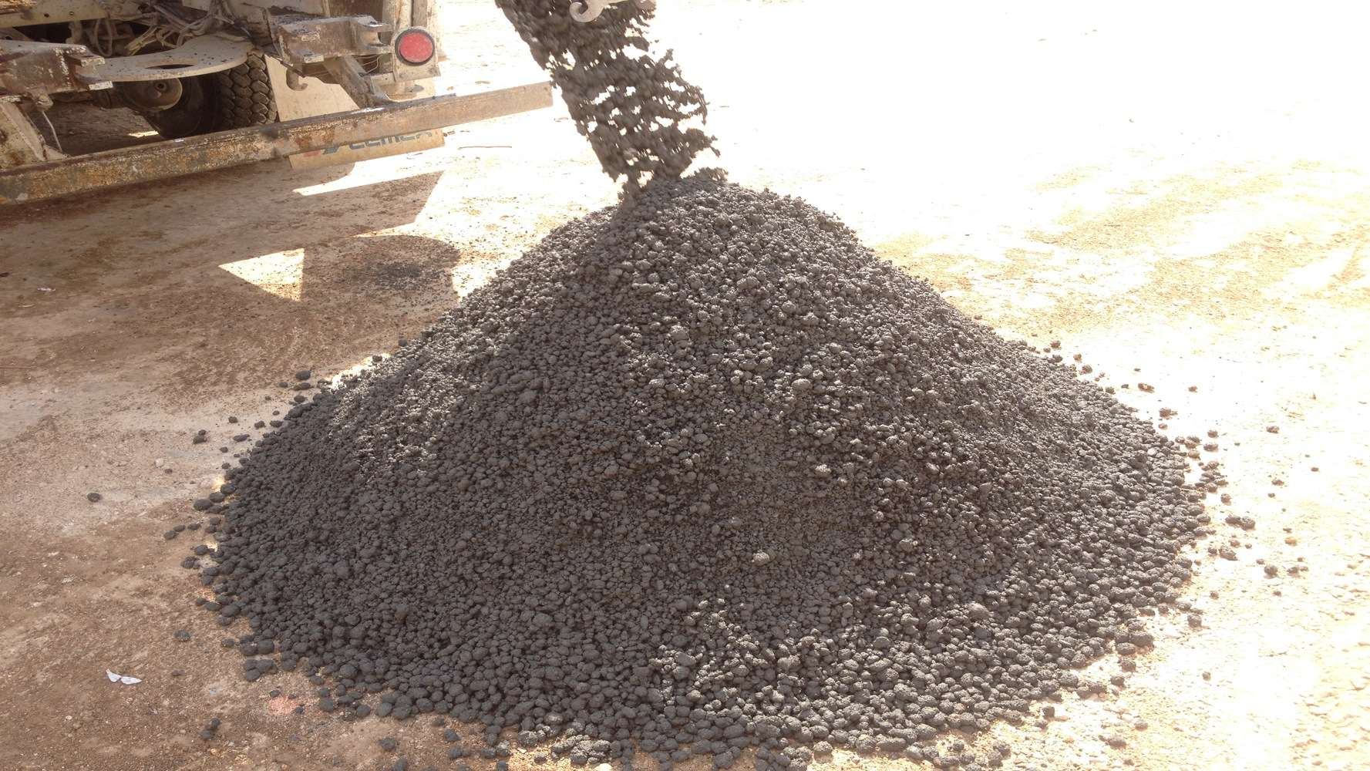
Pelletization
Technologies developed to promote the pelletization of fines or of returned concrete.
CHARACTERISTICS
Portfolio of products developed to provide opportunities to beneficiate either returned concrete, or fines/wastes which are not used by the concrete plants.
In both cases, artificial aggregates are produced and can be reused in regular concrete production
VALUE PROPOSITION
  Simple application: water-soluble bags to be doses directly in the RMX truck
  Robust: will work with any type of “waste”
  Circular economy: reducing wastes
  Economically beneficial
TECHNOLOGY
ISOFINES
ISOCYCLES

