Slide 1
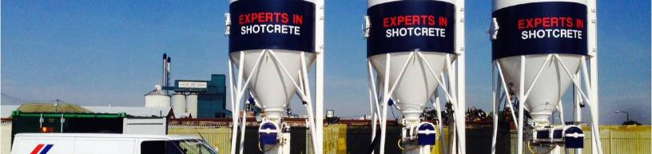
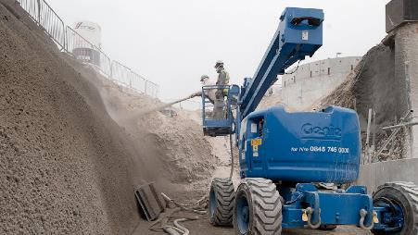
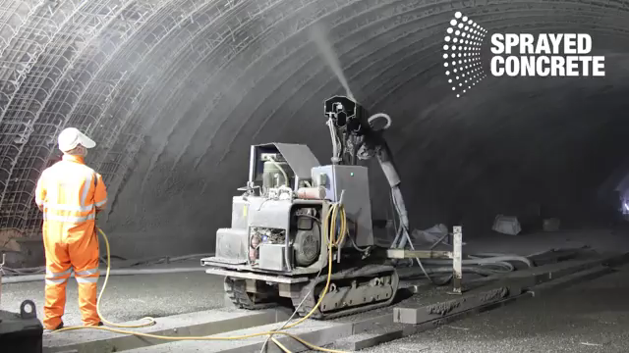

Sprayed
Concrete conveyed through a hose and pneumatically projected at high velocity onto a surface, as a construction technique.
CHALLENGES
Shooting characteristics are poor to the equipment
Labor / time required to get structural or finish coats
Mesh or steel placement
VALUE PROPOSITION
  Design considerations to the equipment used (nozzle size)
  Integral reinforcement available to increase production
  Improved production time (sqft day)
TECHNOLOGY
ISOXEL
ACCEL

