Slide 1
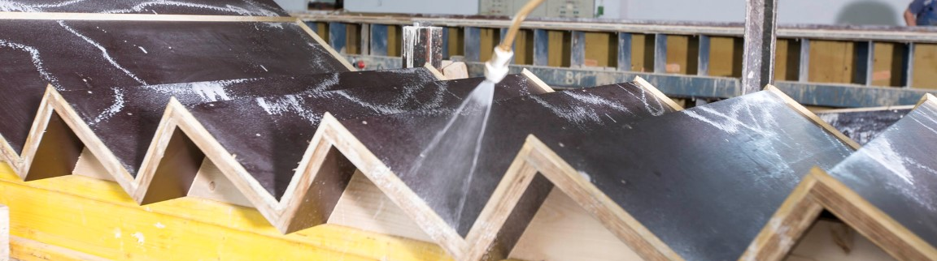

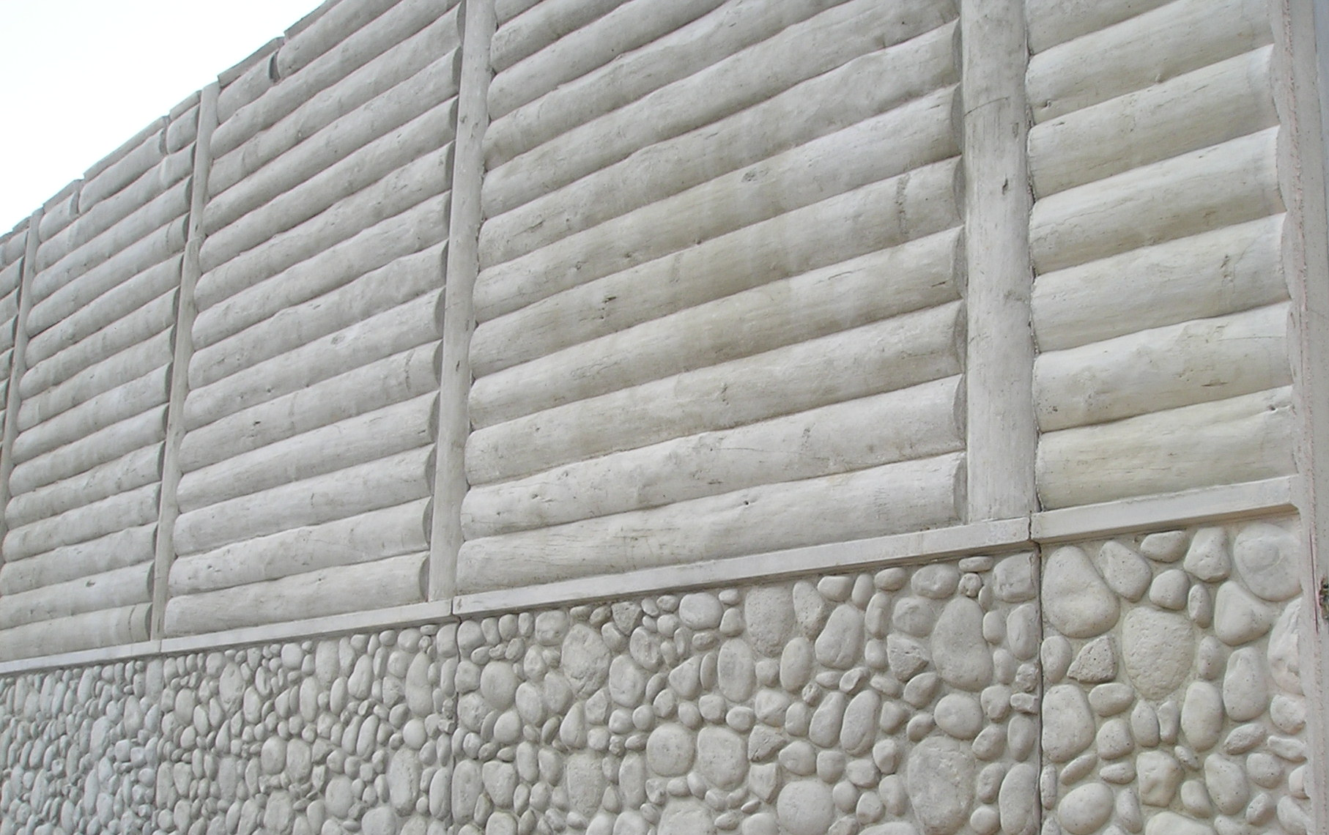
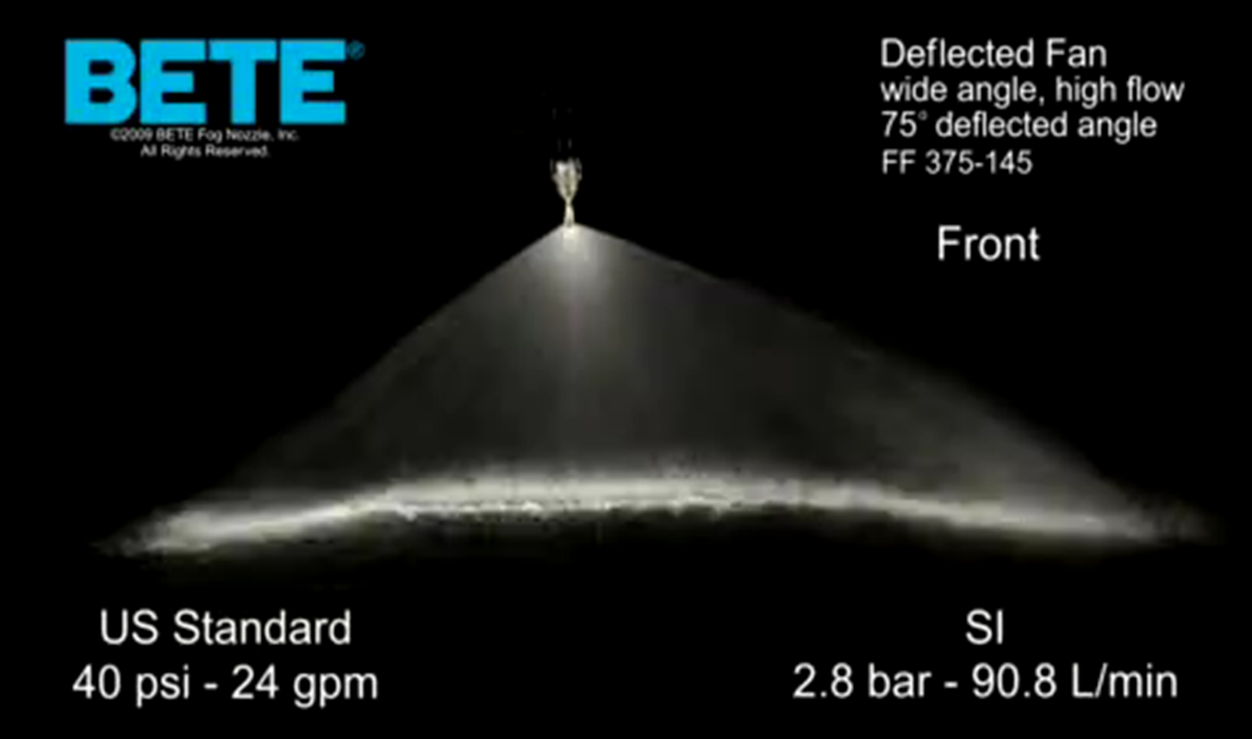
Demolding Oil
Portfolio of products for the easy removal of formworks.
CHARACTERISTICS
Products are designed based on the type of formwork, to allow for an easy removal and cleaning of formworks.
Will also help to obtain a good concrete surface.
Specific products have been designed for
  wooden formwork, to prevent the rapid absorption of the oil.
  Foam concrete, to prevent the defoaming behavior and holes on the surface
VALUE PROPOSITION
  Biodegradable products available
  Wide range of portfolio to cover all applications
  Optimized viscosity for easy application
TECHNOLOGY
ISOFORM

