Slide 1
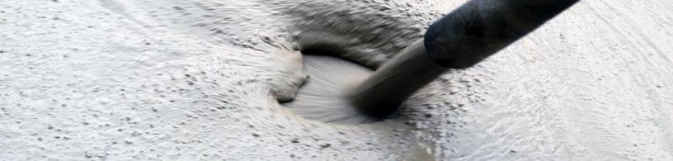
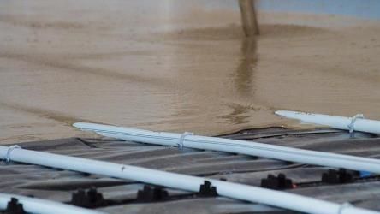

Anhydrite Screed
Self-compacting, pumpable screed based on a calcium sulfate binder.
MOTIVATION
Substitution of the conventional screed (dry) with self leveling advantages
VALUE PROPOSITION
  Speed of application
  Reduction in labor cost
  Increased site logistical efficiency
  Accuracy of placement and finishing,
  Reduction in thickness
  Elimination of curling
TECHNOLOGY
ISOFLOW

