Slide 1
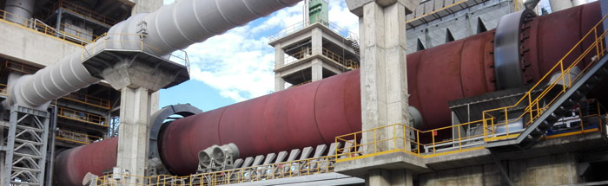

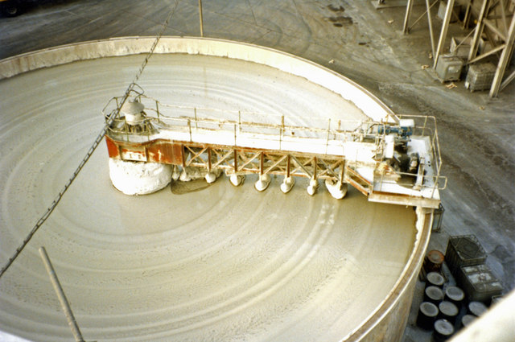
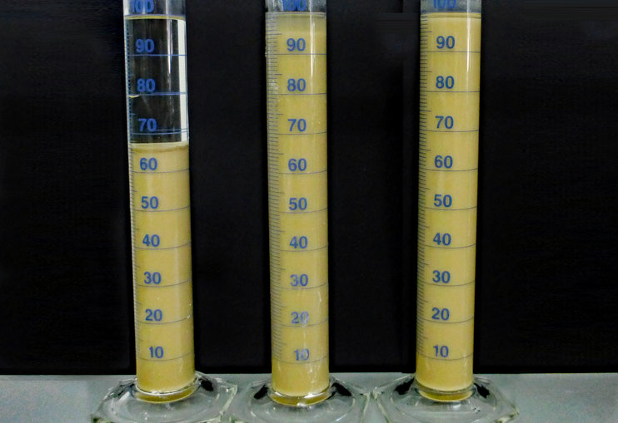

Slurry Additives
Chemicals used to stabilized mineral slurries, notably for wet kiln applications.
CHARACTERISTICS
Additives used to stabilized typical slurries which are made of limestone, clay, chalk, and similar minerals.
Solid content my be up to 75%
The product is typically injected during the wet grinding process.
The additive will also improve the production and reduce the energy needs.
VALUE PROPOSITION
  Higher Solid Content of the slurry
  Lower Slurry Viscosity
  Good pumpability
  High stability especially towards sedimentation
TECHNOLOGY
ISOMILL

Slide 2
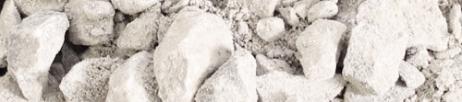
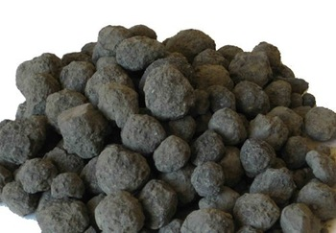
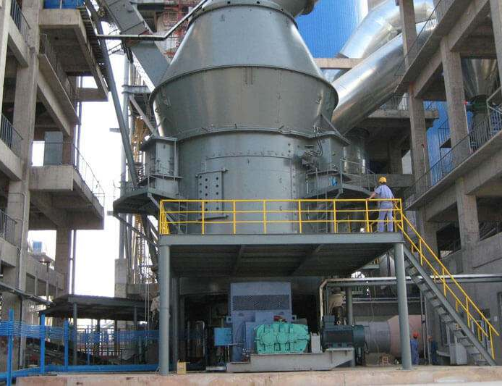
Raw Meal Additives
Grinding aids especially designed for the dry grinding of the raw materials used for clinker production.
CHARACTERISTICS
Chemicals selected to improve the grinding of the raw materials for clinker production, notably limestone.
Production increase can typically reach 20%.
Injected during the grinding process as any liquid additive
VALUE PROPOSITION
  Can be used with both ball and vertical mills
  Typical dosage range: 250 - 1000 ppm
  Compatible with most of raw materials
TECHNOLOGY
ISOMILL

Slide 3

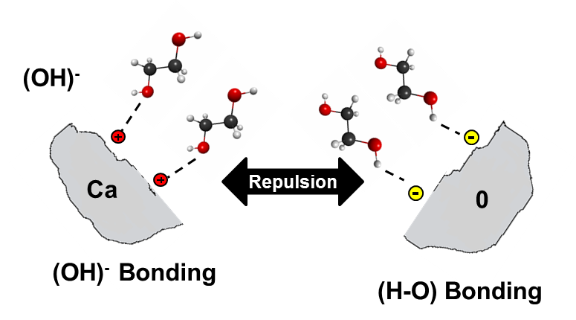
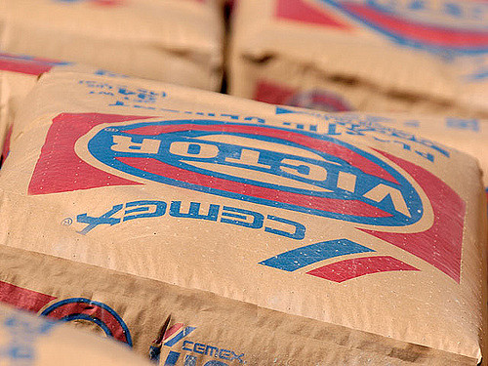
Cement Grinding Aids
Grinding aids developed to reduce the energy needs and to improve the productivity of cements
CHARACTERISTICS
Chemicals selected to improve the grinding of clinker and additions, in ball and vertical roller mills.
Production increase can typically reach 20%.
Injected during the grinding process on the fresh feed.
VALUE PROPOSITION
  Optimization for all types of cements
  Typical dosage range: 250 - 1000 ppm
  Chemically stable to mill temperature
TECHNOLOGY
ISOMILL

Slide 4
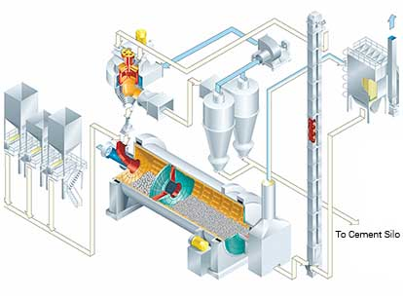
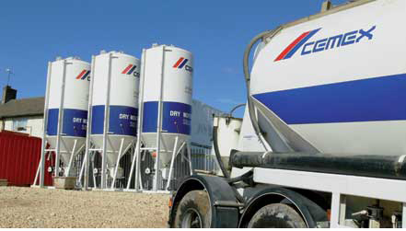
Pack-Set Reducing Admixture
Additives developed to reduce the Pack-Set of cement
CHARACTERISTICS
The additives will help reducing the pack-set of the cement, during the grinding process.
The products can be as well designed to function as grinding aid.
Chemicals are selected specifically based on the cement type.
It will help the unloading and transport to and from the silos
VALUE PROPOSITION
  Optimization for all types of cements
  Can be combined with other additive types
  Compatible with ball and vertical roller mills
TECHNOLOGY
ISOMILL

Slide 5
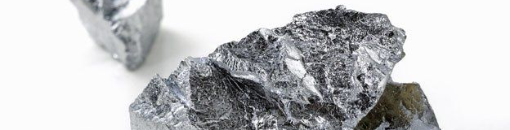
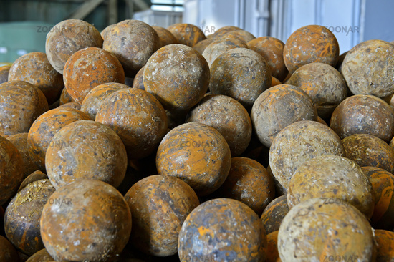
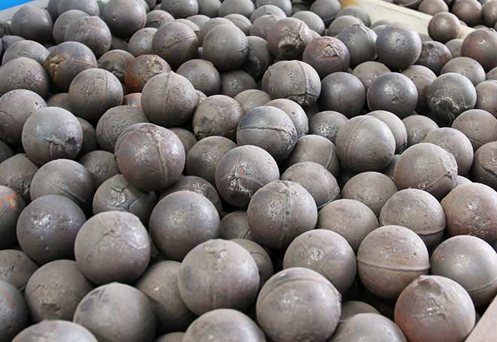
Chromate Reducers
Products specifically used to control the level of Cr^{VI} in cements
CHARACTERISTICS
The chemicals will target the remaining Cr^{VI} and will reduce it to non-hazardous Cr^{III}.
This product is particularly advised for ball mills.
Can be provided as a powder or as a liquid
VALUE PROPOSITION
  Compatible with all other additives for cement
  Dosed in the grinding process
TECHNOLOGY
ISOCROME

Slide 6
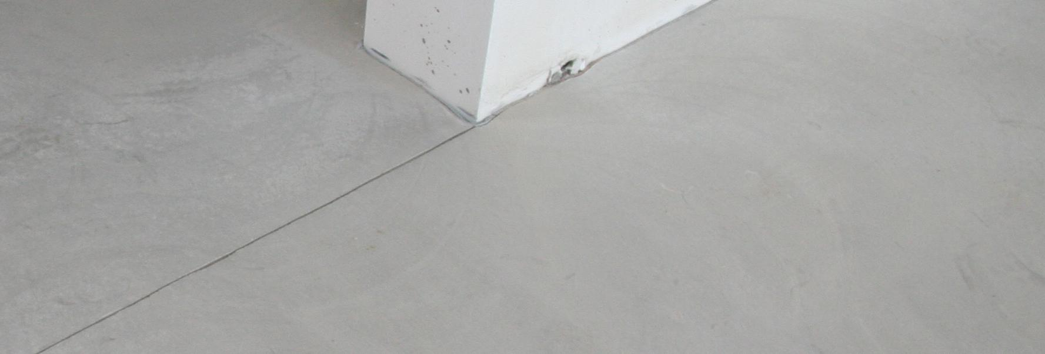
Strength Enhancers
Chemicals designed to increase the strength of cement at specific ages.
CHARACTERISTICS
The chemicals used in the product will support the cement hydration and increase the strength at different ages.
A formulation can be designed to target either the early or the late strength, or both.
Clinker factor will be expected and would typically be in the range of 2-8%.
VALUE PROPOSITION
  Increase of early and late strength
  Typical dosage range: 250 - 1500 ppm
  Can also act as grinding aid
  Can be combined with all other types
  of cement additives
TECHNOLOGY
ISOMILL

