Slide 1
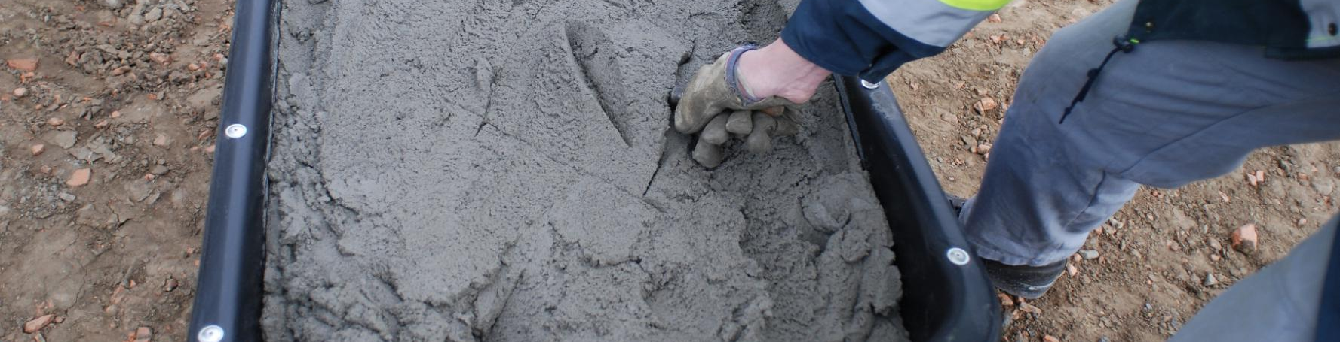
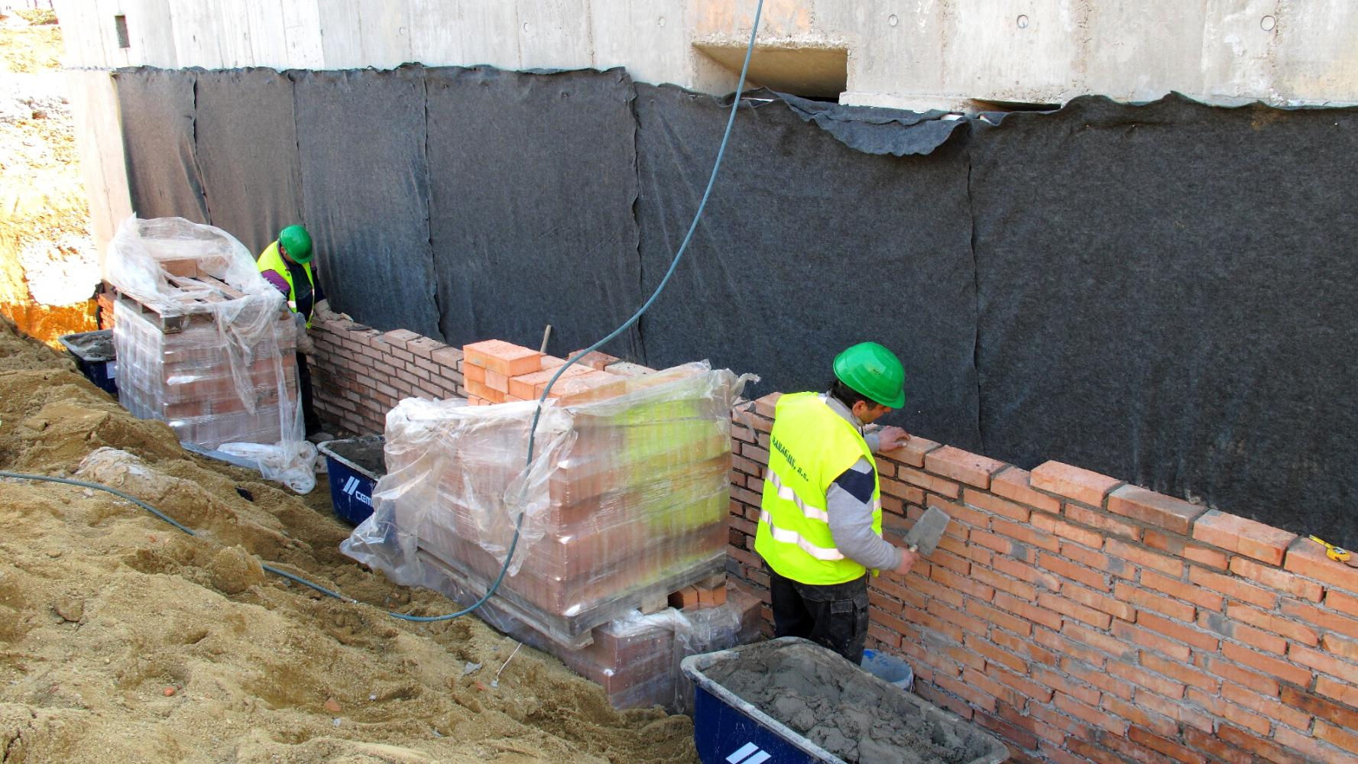
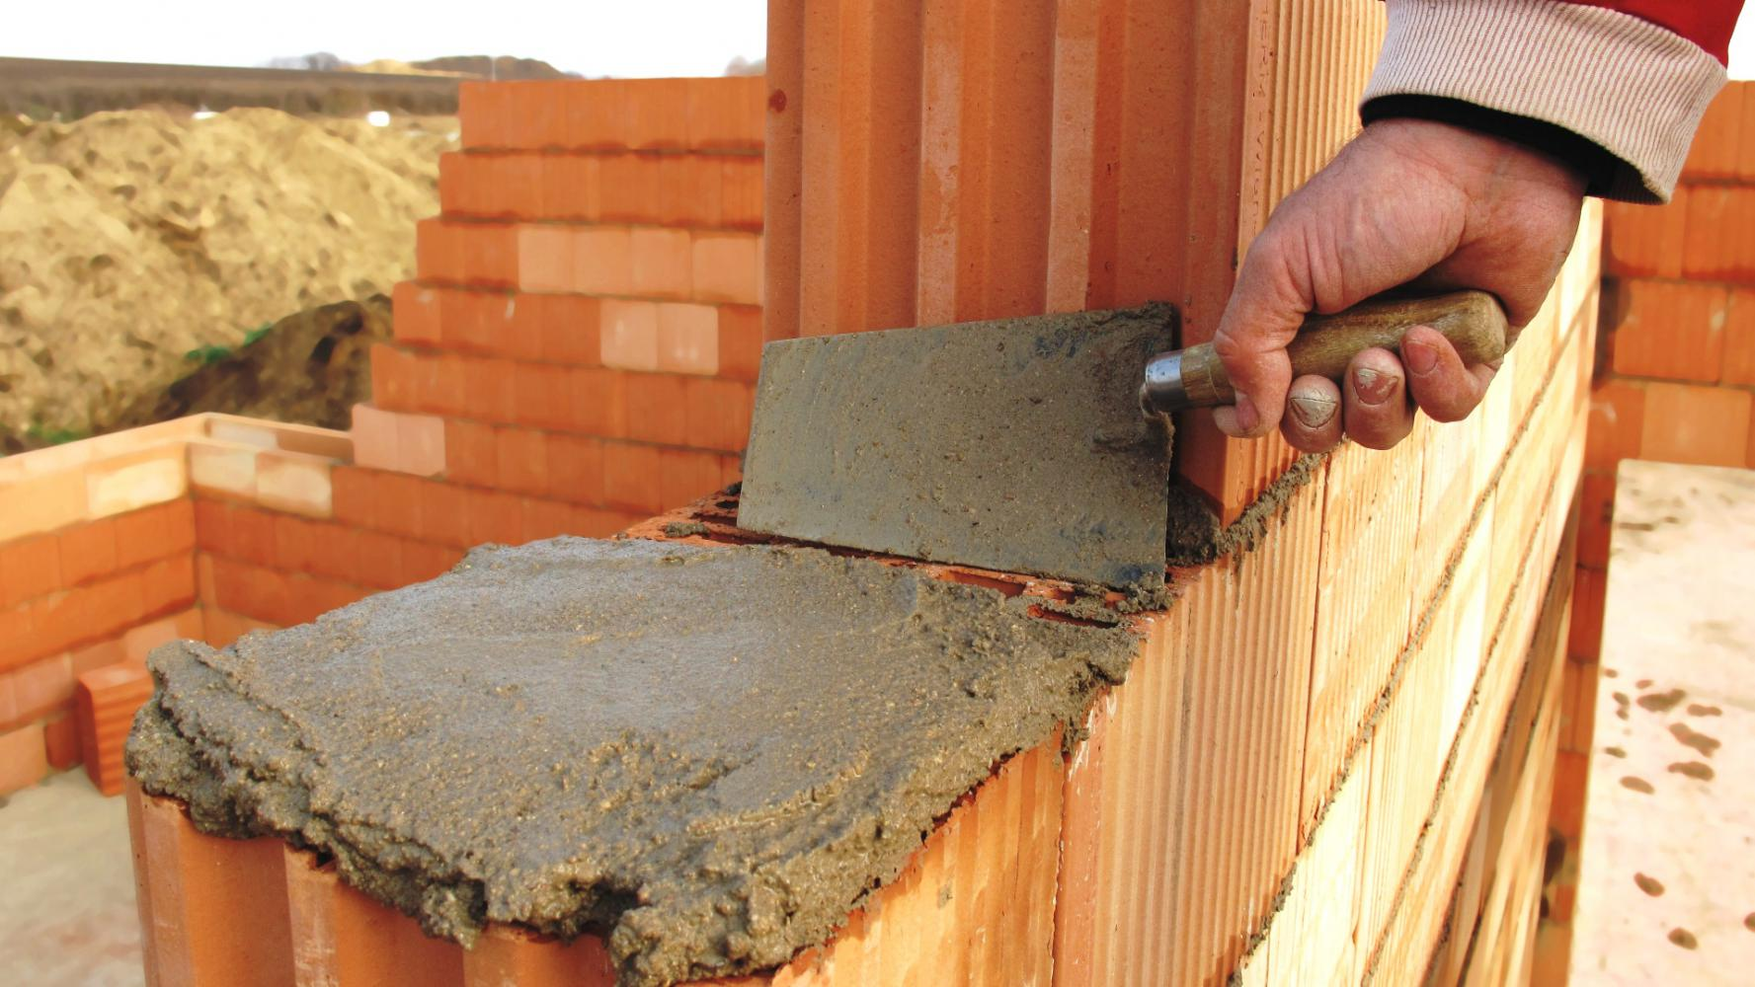
Mortar
High quality mortar delivered in ready to use
DESCRIPTION
Cement masonry mortar with a workability of up to 36 hours is designed for buildings
VALUE PROPOSITION
  Ready to use with no further mixing
  Improved adhesion to masonry materials
  Superb workability without excessive air content.
  Perfect for brick / blocks layering
TECHNOLOGY
ISOPLAST
ISOSTAB

