Slide 1
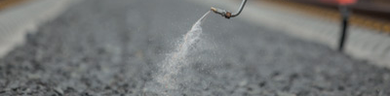

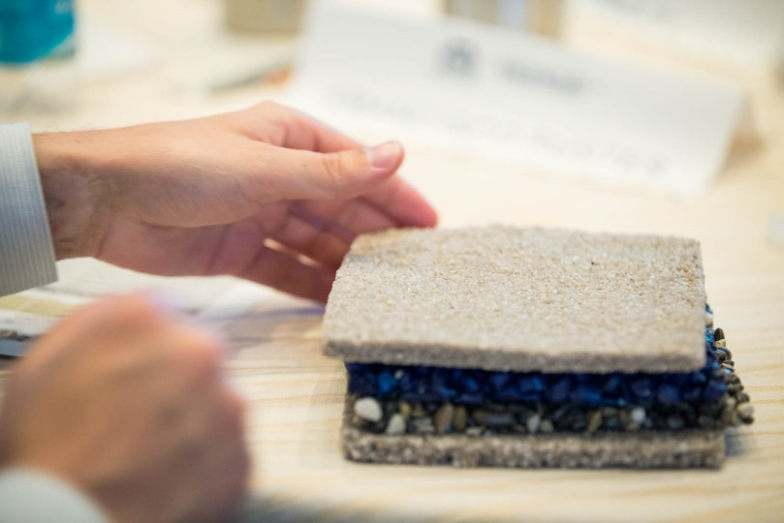
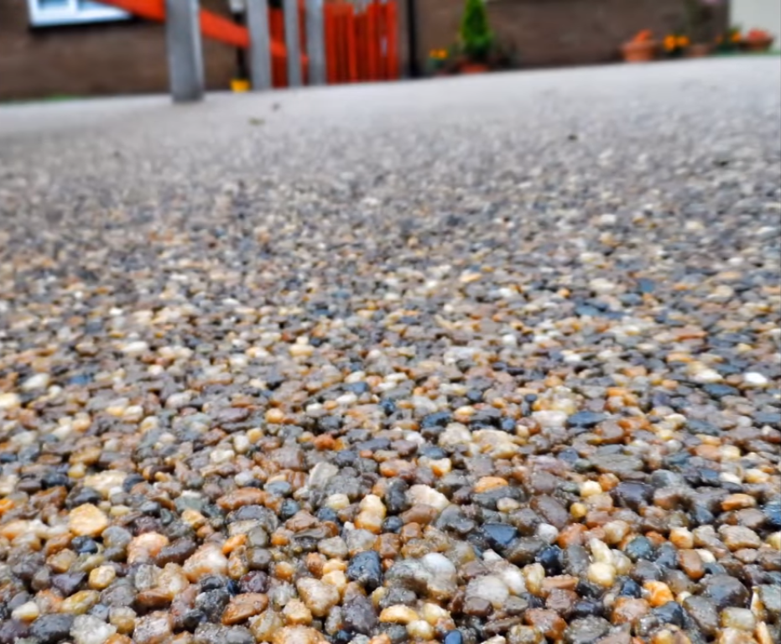

Bonding Agent
Admixtures that provides bonding performances for either mortars or aggregates
CHARACTERISTICS
Technologies designed on film forming polymers which will provide a bonding agent while drying.
The film can be adjusted with respect to its stickiness, flexibility and water resistance.
Different products are available for each specific application
VALUE PROPOSITION
  Tailor-made products
  Biodegradables solutions available
  Versatile and robust: works with most substrates and
  raw materials
TECHNOLOGY
ISOBOND

