Slide 1
Flourishing concrete
September 2022

Slide 2
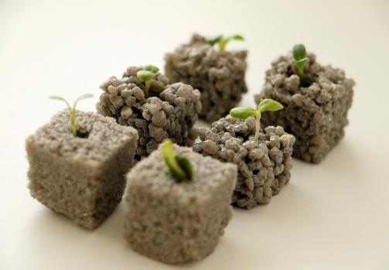
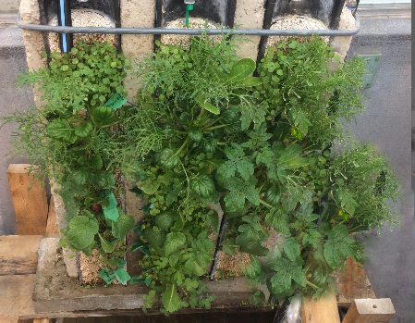
FLOURISHING CONCRETE : Concept
Growing substrate and green infrastructure solutions: using porous concrete for controlled plant growth
Mineral Growing Substrate
Green Wall ( Video)

Slide 3
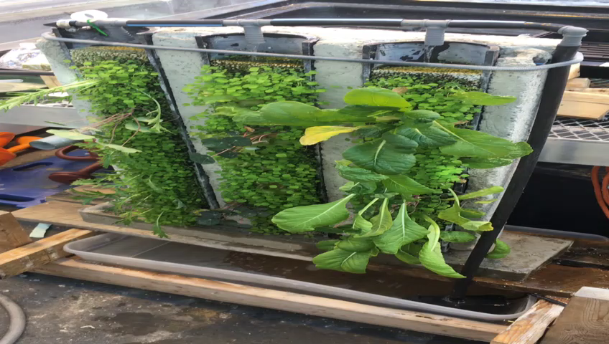
FLOURISHING CONCRETE : Concept
Growing substrate and green infrastructure solutions: using porous concrete for controlled plant growth
Mineral Growing Substrate
Green Wall ( Video)

Slide 4
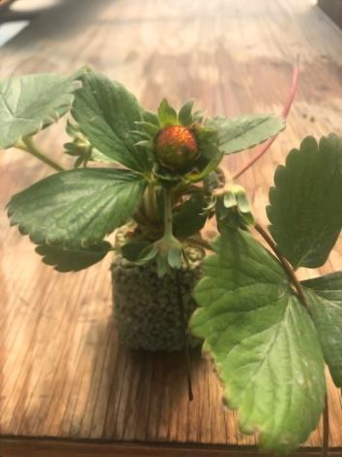
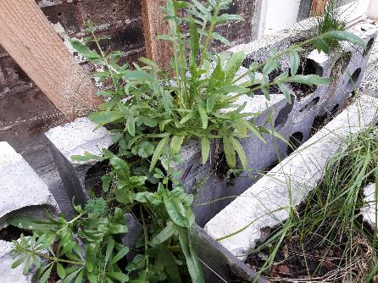
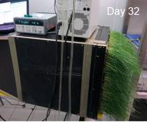
Flourishing concrete : Examples
Biodiversity
Air purification
Crops farming

Slide 5
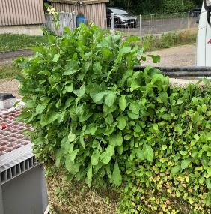
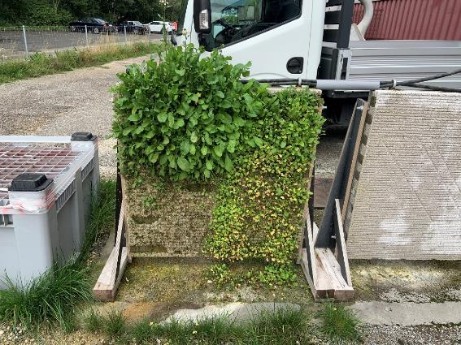
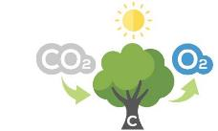
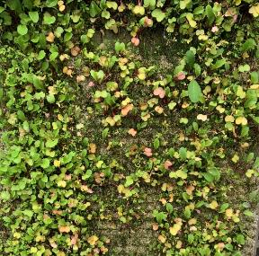
FLOURISHING CONCRETE : prototyping
REMOVAL OF POLLUTION
DIRECT AIR CAPTURE, COOLING, NUTRITION
TIMELINE
Catalog of Green Structures
Mapping Existing Applications
Vertical & Horizontal Prototyping
Market Feasibility & Attractiveness
Upscaling to Green Structure
Move to
PILOT PHASE

Slide 6
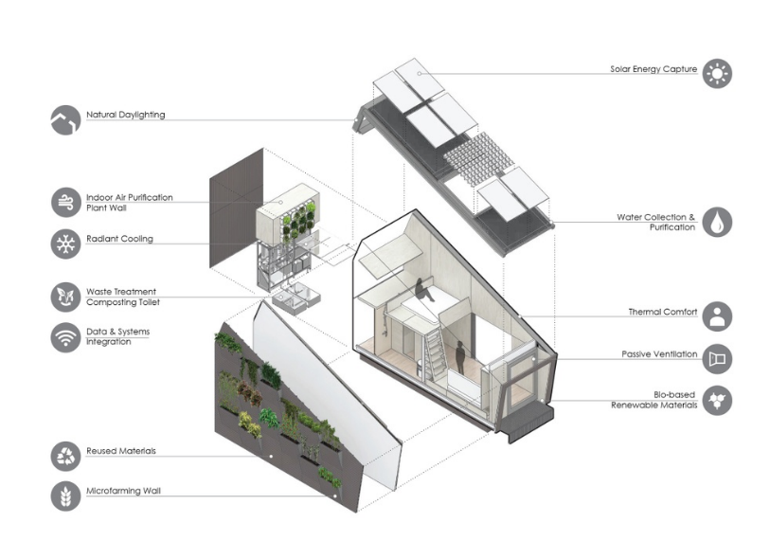






PILOT PROJECT : eco system housing module

