Slide 1


Slide 2

MILESTONES
OVERVIEW
Jobsite
February 10 to 13th
Overview……………………………..………………...……..……
Production of concrete……………..………………….….……..
Specific preparation…..…………………………………….…….
Placement…………………………………….…………….……..
Finishing……………………………………………………………
Final Result………………………………………………………..
Performance at 7 days………………………………………………
Performance at 28d [available on March 13th] ….…………….
Cost analyses……………………………………………………..
Next steps……………………………………………………………
Mechanical
Performance
Cost & Next steps

Slide 3
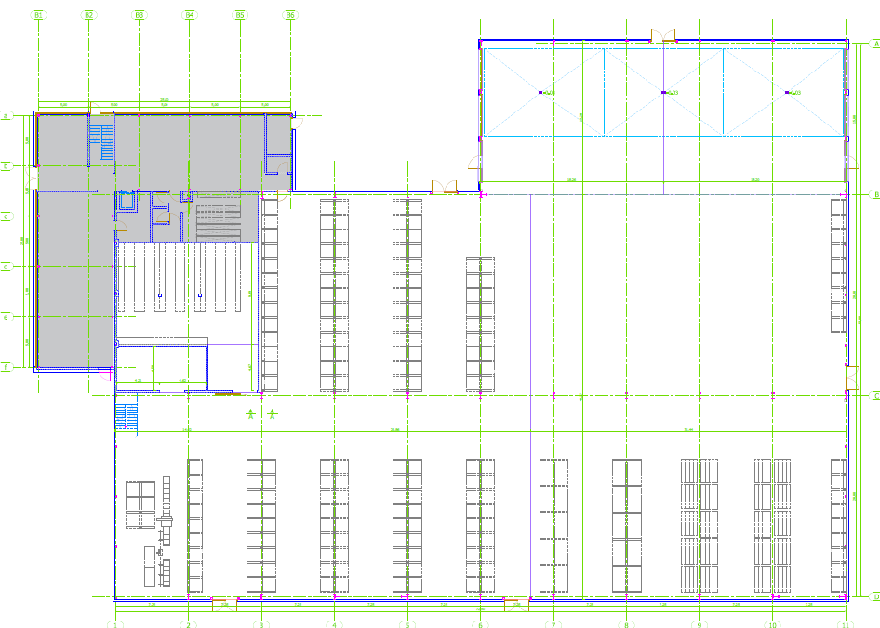
- Overview
Jobsite in data
Customer: HORMANN
Location: near Lyon, concrete delivered from plant Satolas (Pusignan)
Volume of RESILIA: 680 m³
Surface without joints: 1200 m²
Industrial slab / storage platform
4 days-casting: Day 1 - 100 m³
Day 2 - 240 m³
Day 3 - 240 m³
Day 4 - 100 m³
Slope
DAY 1
DAY 4
Joint
DAY 2
Concrete pumped
(20m³)
DAY 3
2 joints

Slide 4
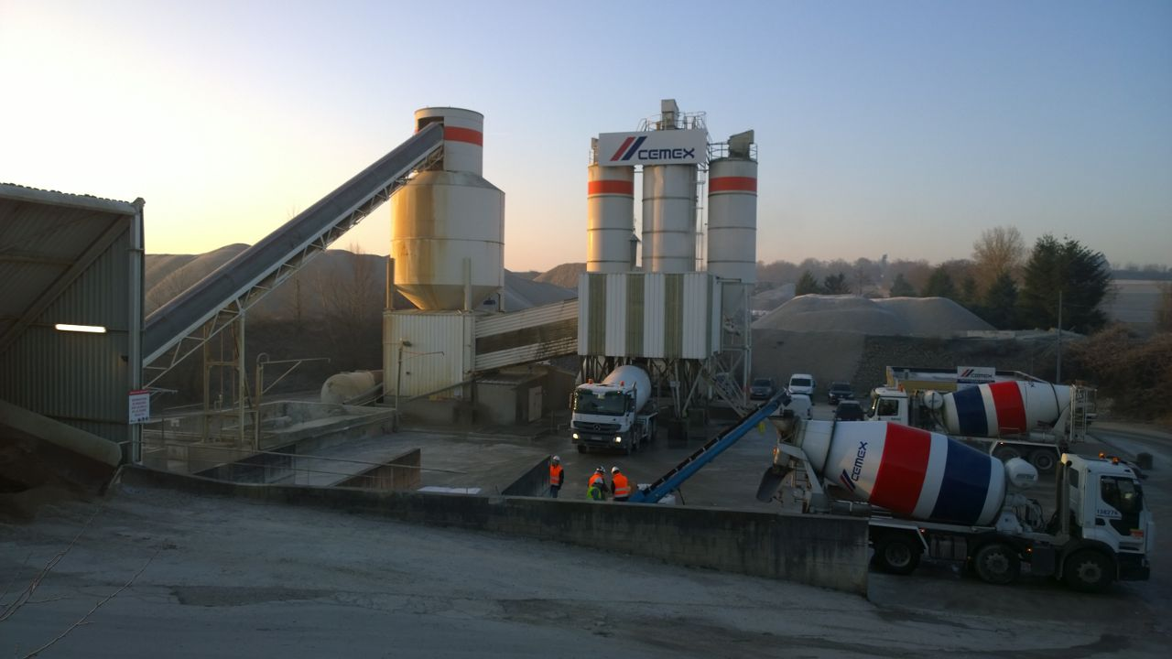
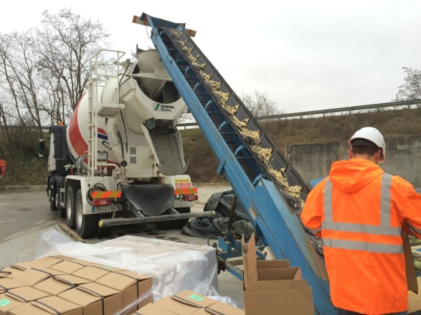
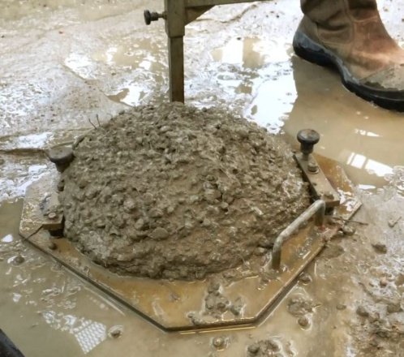
- Production of concrete
Description
2m³-planetary mixer
1.88m³-batch, mixing 35 sec
Fiber added after batching, in the truck – additional 5 min mixing
5 min-transportation to jobsite
Slump 220 ± 10 mm
CEM I 42.5N | 300
Fly Ash | 200
W/B_{eq} | 0.49
ISOFLUID 71 | 4.0
ISOKHORE 120 | 8.0
0/4 Round | 746
4/12 Round | 746
G/S | 1.00
Arcelor HE 1.0/50 | 40
Bekaert RC-80/30-BP | 20
Owens Corning HP12 | 1.60
Concrete plant “Satolas” (East of Lyon)
Addition of fiber on plant,
after concrete batch
220 mm-slump

Slide 5
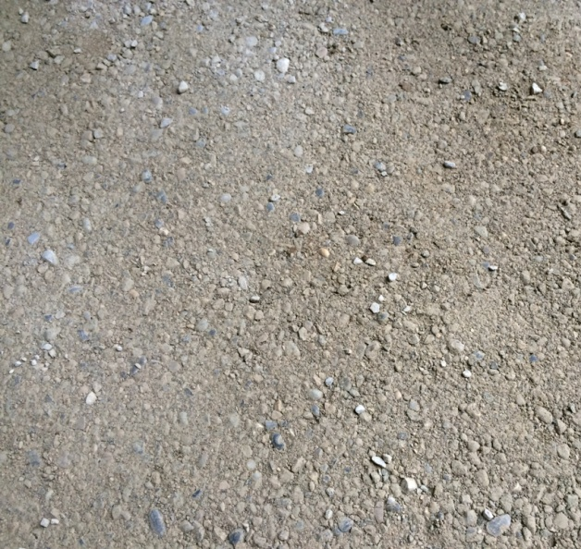
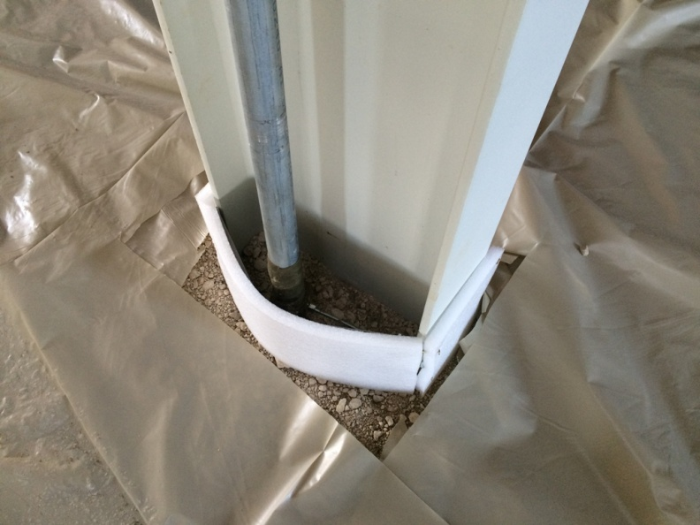
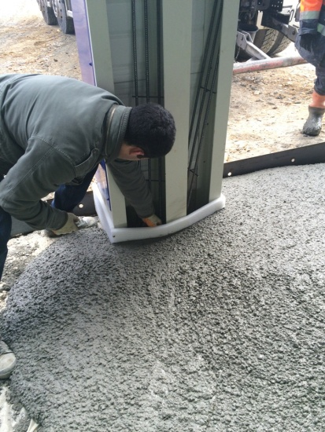
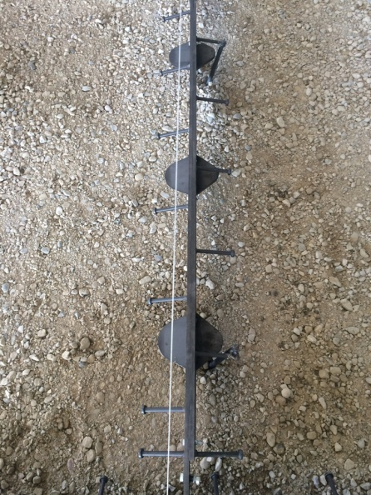
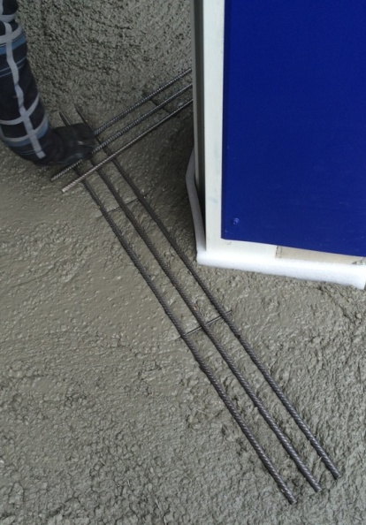
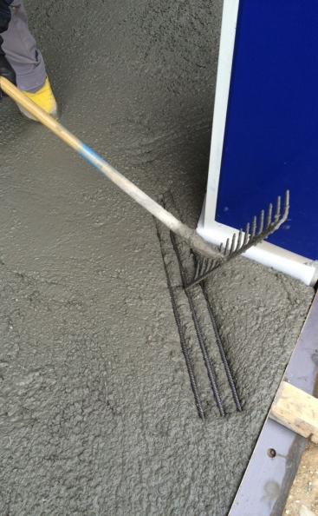
- Specific preparation
Insulation of IPN pillars + reinforcement
Soil preparation:
mix of sand and gravel, covered with Polyane sheet
Joint with dowels

Slide 6
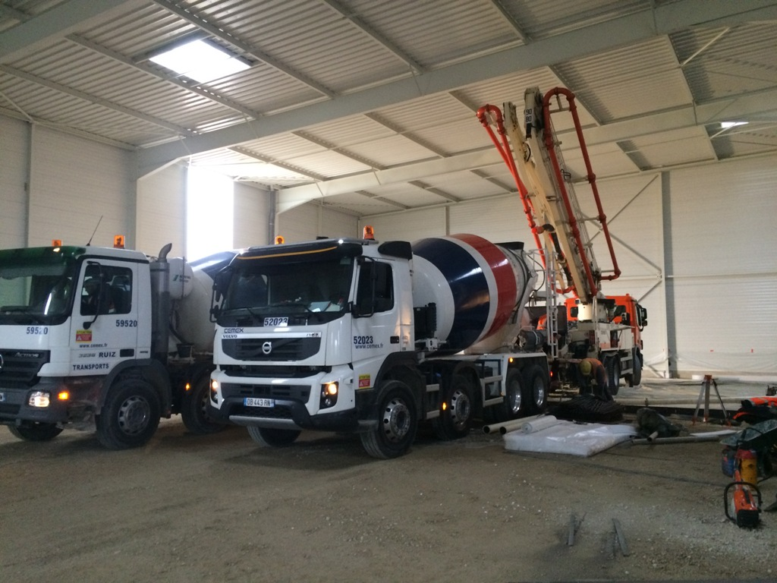
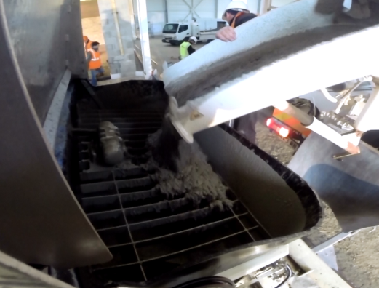
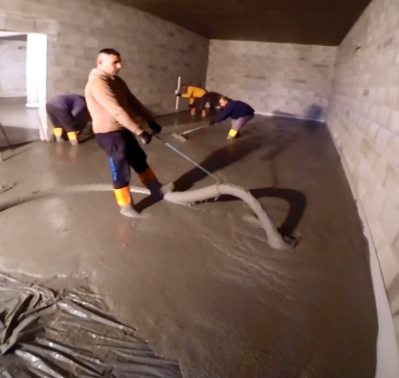
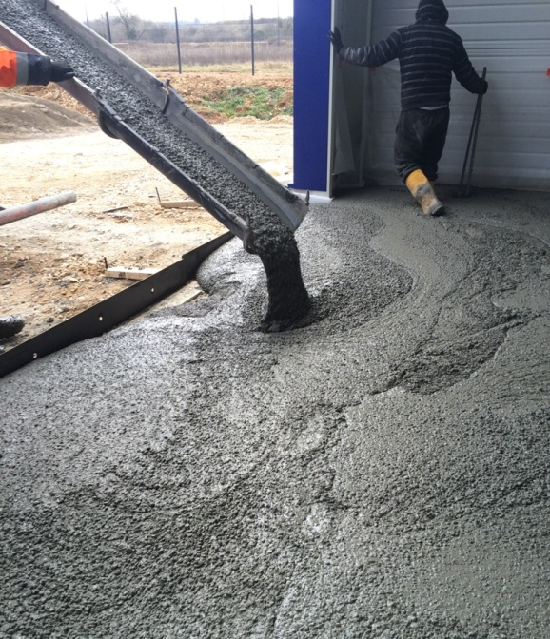
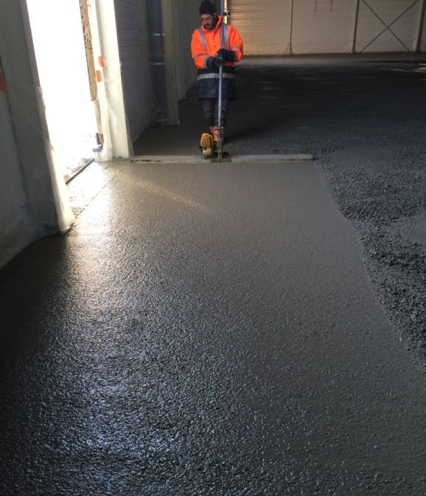
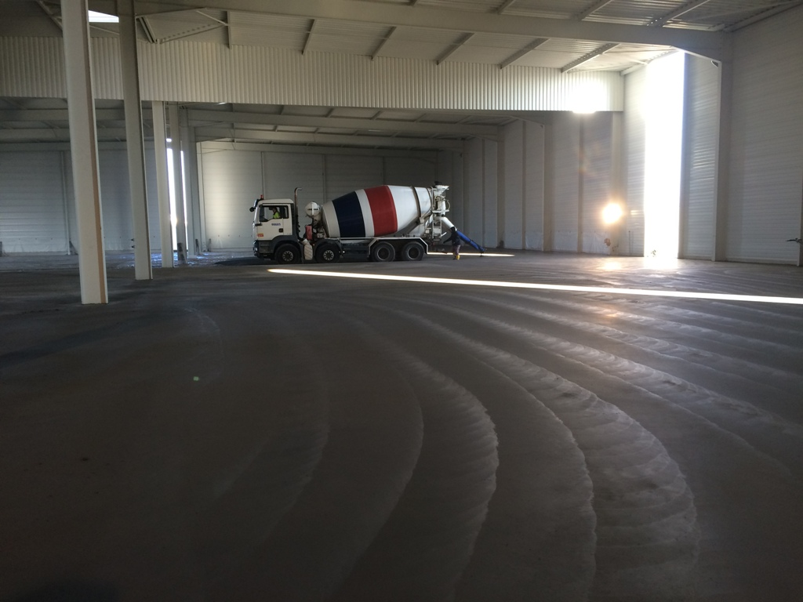
- Placement
RESILIA is easily pumped
Concrete pumped when not accessible by direct discharge
Easy placing
Vibrating ruler
Concrete directly discharged from the truck

Slide 7
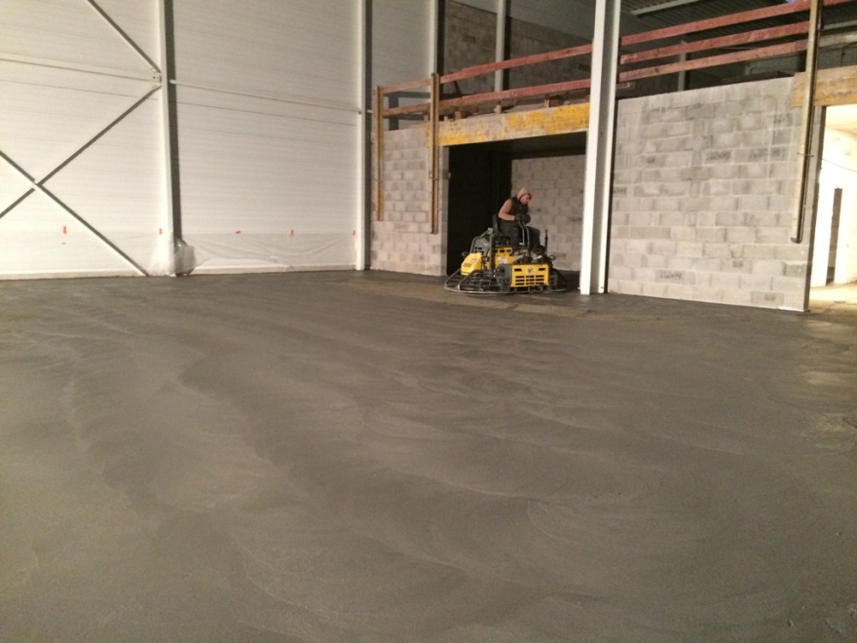
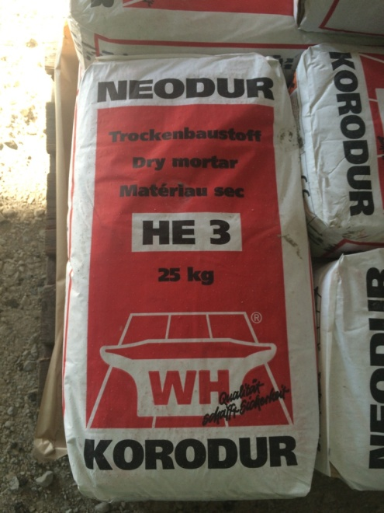
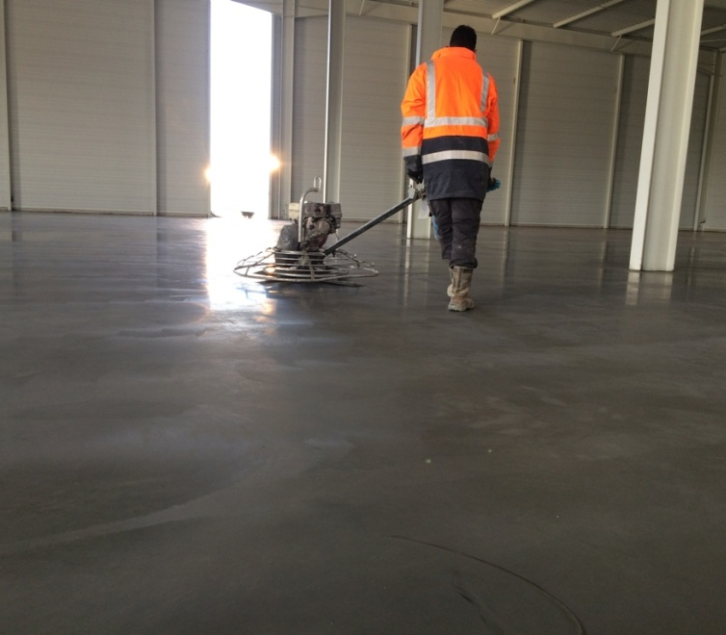
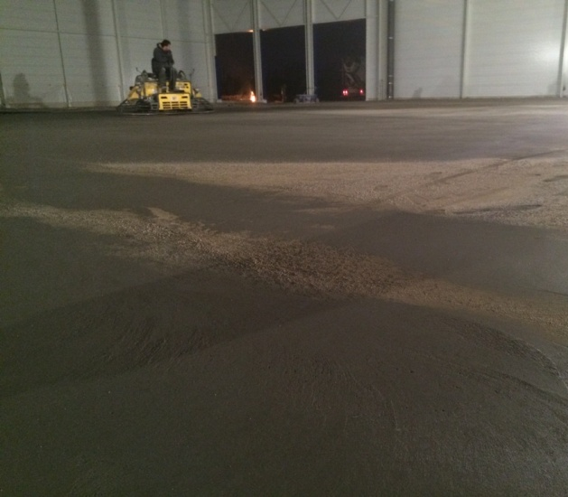
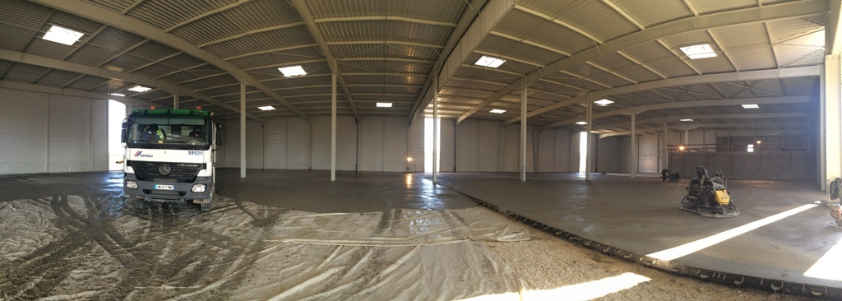
- Finishing
Surface treatment: hardener (dry mortar)
DAY 1
DAY 2
DAY 3

Slide 8
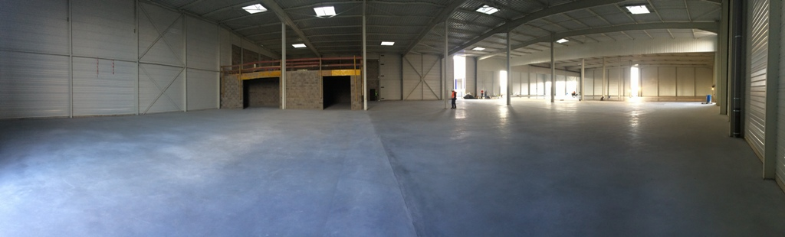
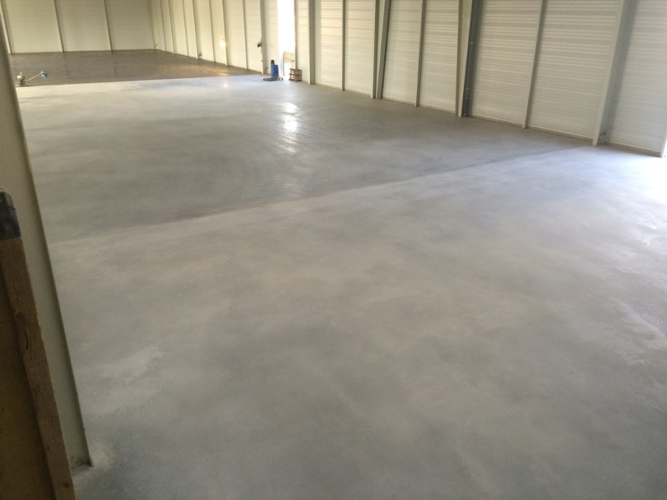
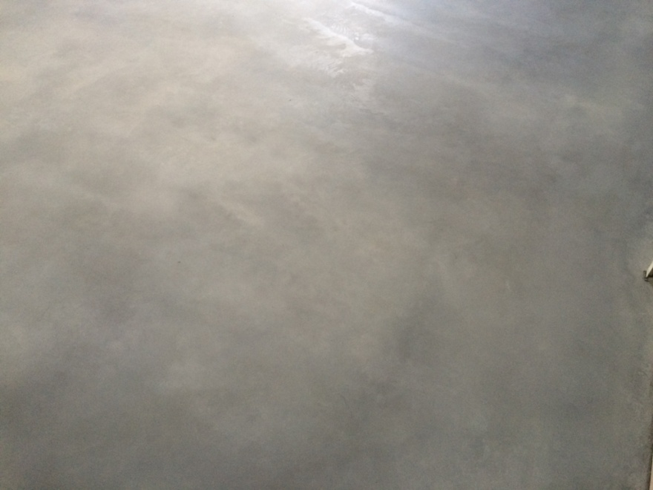
- Final result [1/2]
DAY 4
DAY 3
DAY 2
DAY 1
High quality surface finishing, no visible fibers

Slide 9
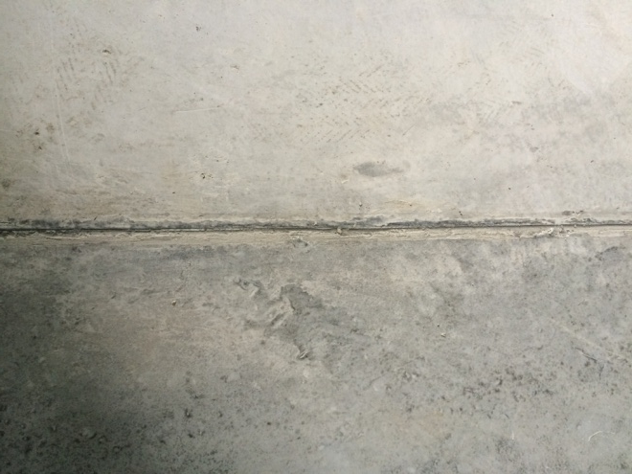
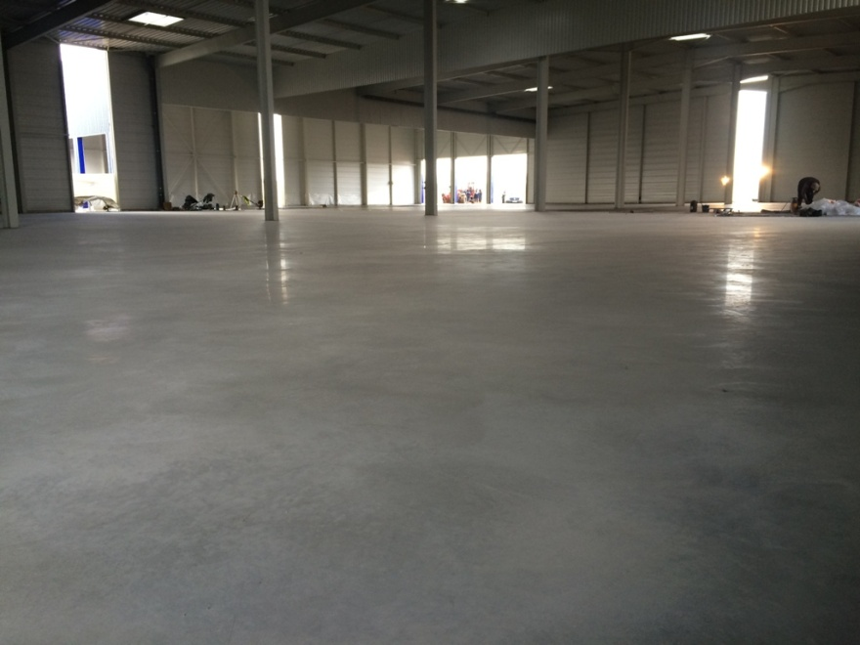
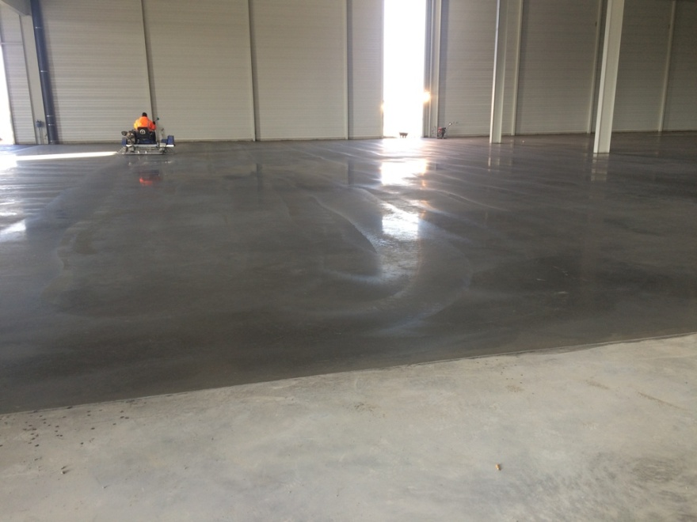
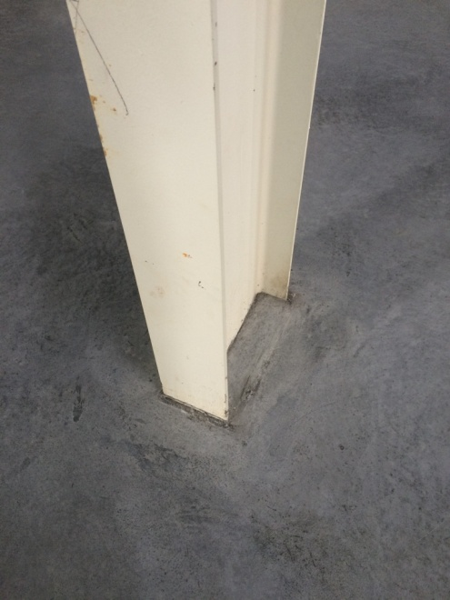
- Final result [2/2]
No visible shrinkage
(joint not open after 3 days)
High quality surface finishing

Slide 10
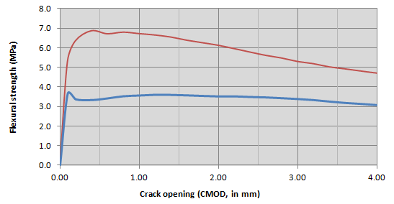
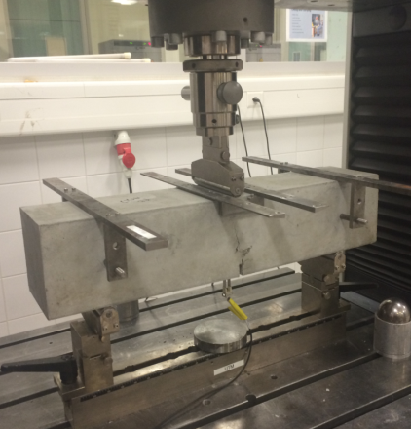
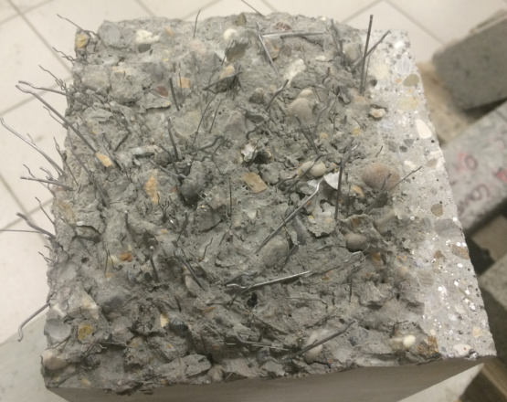
- Performance at 7 days
Flexural strength of RESILIA at 7d (average of 3 beams)
Strength at first crack: 4.44 MPa
Max. registered: 7.0 MPa
Good bridging of micro cracks
Conventional Fiber Reinforced concrete with 40 kg of Arcelor HE 1.0/50
Report from external lab ABC
Compressive strength
2 days 9.8 MPa
7 days 34.7 MPa
Density (average on all samples): 2252 kg/m³
UTM – set-up to measure flexural strength (acc. to EN 12390-5)
Good repartition of fibers

Slide 11
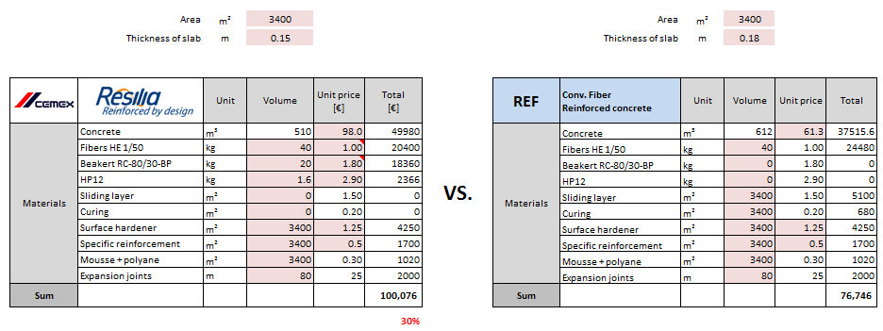
- Cost analyses [1/2]
Cost review with Mr. Helder GASPAR (H.Sols) – 18.02.2015
Some details…
Sliding layer: 1.50 €/m²
Curing compound: 0.20 €/m²
Foam + Polyane: 0.30 €/m²
Surface hardener: Quartz: 0.10 €/kg, 5kg/m²
KORODUR 0.25 €/kg, 5kg/m²
Metallic: 0.701 €/kg, 8 kg/m²
Feedback…
France: administrative / insurance issue with new design, would be difficult to promote RESILIA
For H.Sols, target market is Germany – no such issue like in France with insurance.
Issue with hardener / curing: cracking, “faiencage”, delamination → evaluation with BOHMS test
Pumpability is very important.
Case of study: 18 cm of conventional FRC vs. RESILIA

Slide 12
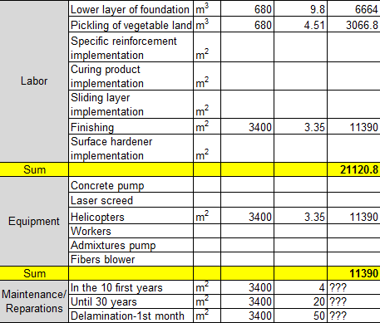
- Cost analyses [1/2]
Other indirect costs…

Slide 13
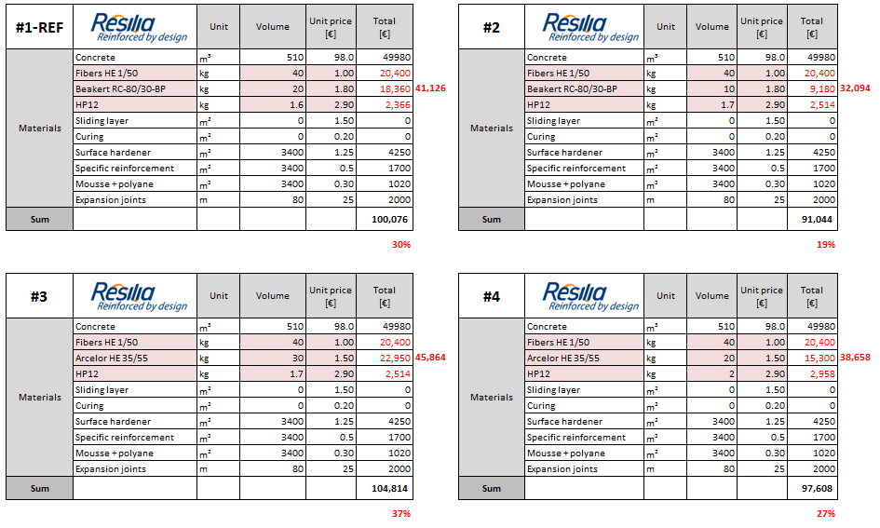
- Next steps [1/2]
1. Main cost reduction expected on Fibers combination

Slide 14
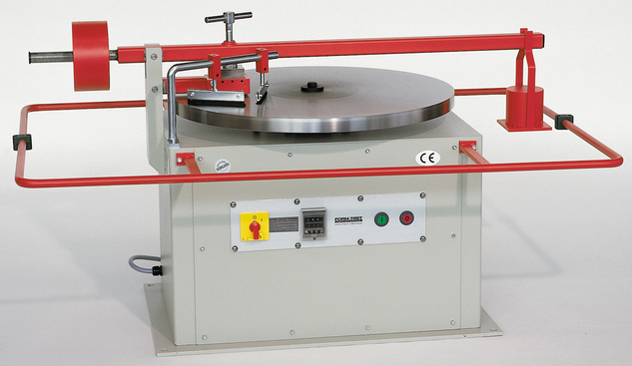
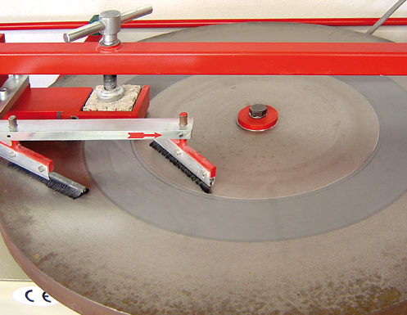
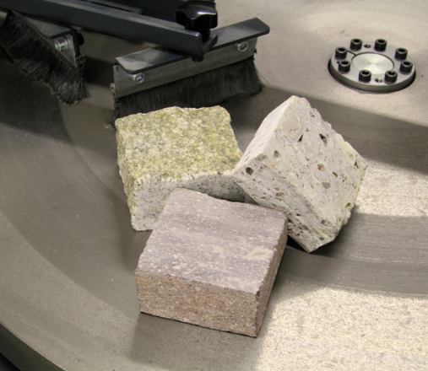
- Next steps [2/2]
Abrasion performance – Böhme test, according to DIN 52108
Issue: check if there’s no delamination when applying surface hardener without additional curing compound
Consider reference concrete. Apply the surface hardener, finish and apply curing
RESILIA: apply the surface hardener and finish.
Conventional test used by H.Sols and its customers: Böhme test

