Slide 1

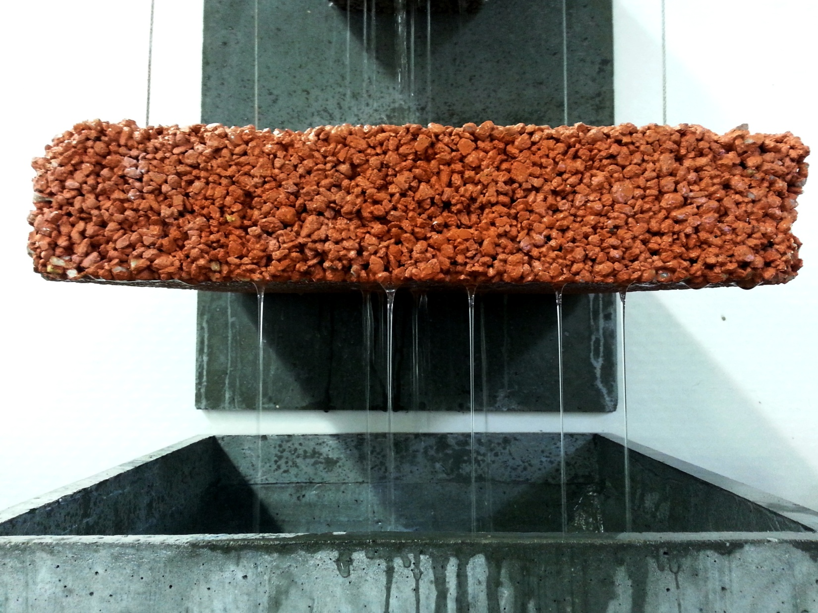
ZOO ST. THIBERY
Report of structural Pervious and Hydraulical design
PRODUCT DEVELOPMENT & CONSTRUCTION TRENDS
Product Development & Industrialization
28/01/2015

Slide 2
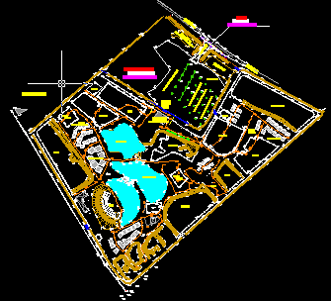
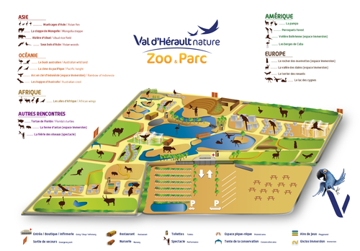
INTRODUCTION – Context of the project
Current situation and motivation
The alleys were built from an impemeble asphalt layer (ca. 1 cm thick) on a “tout-venant” base (0/20 – ca. 20 cm thick). A thin layer of exposed aggregates was used for aesthetic reasons.
Their width is constant and ca. 3.5m on the entire Zoo, and surronded by soil.
⇒ Due to the impermeable nature of the alleys and the natural slope on the site, storm water is is generally accumulated in the main entrance, incl. the handicap parking, and in front of the arena.
Objectives
Ensure a complete management of the storm water: no flooding of the alleys or into the bassins of animals, and in the main entrance/handicap parking area.
In order to respect the continuity for handicap people, a similar pavement on the handicap parking area than in the Zoo will be used.
The proposed design should ultimately integrate the existing drainage already in place.

Slide 3
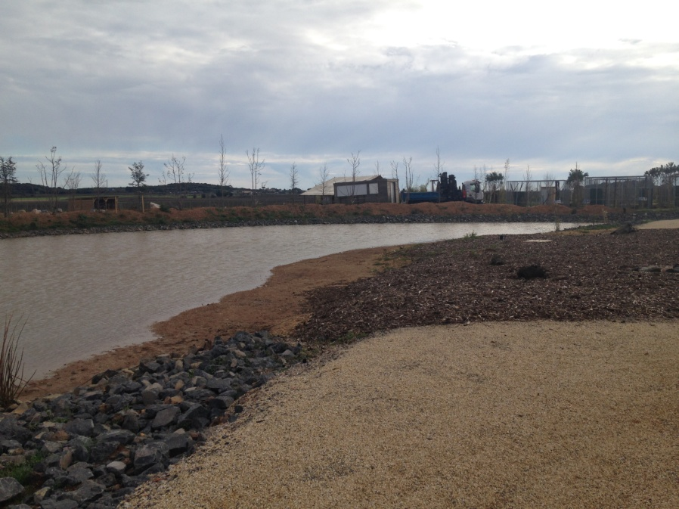
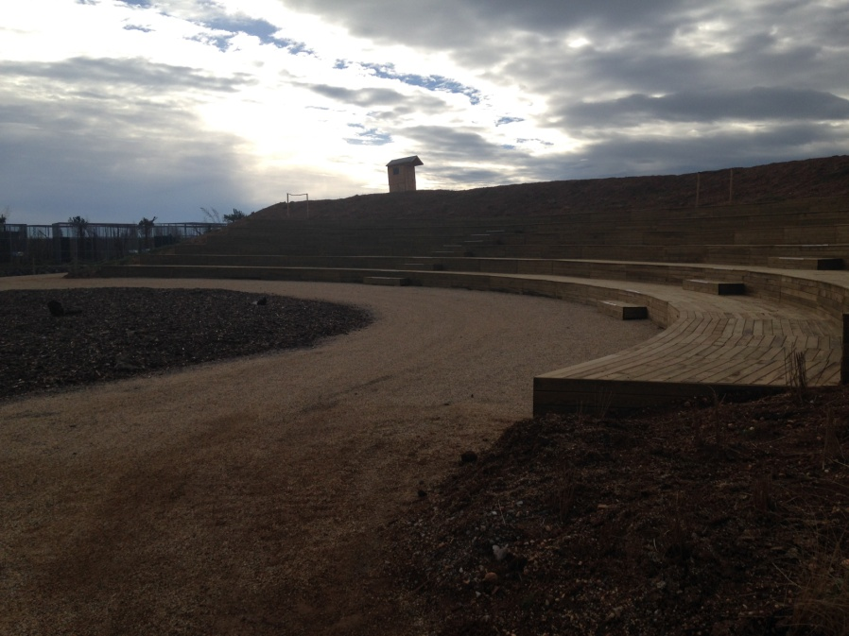
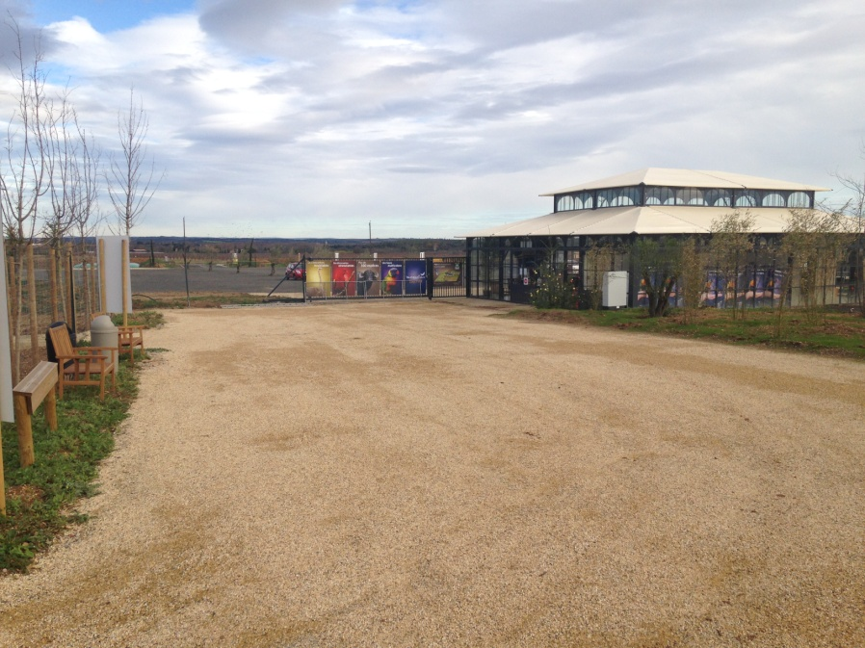
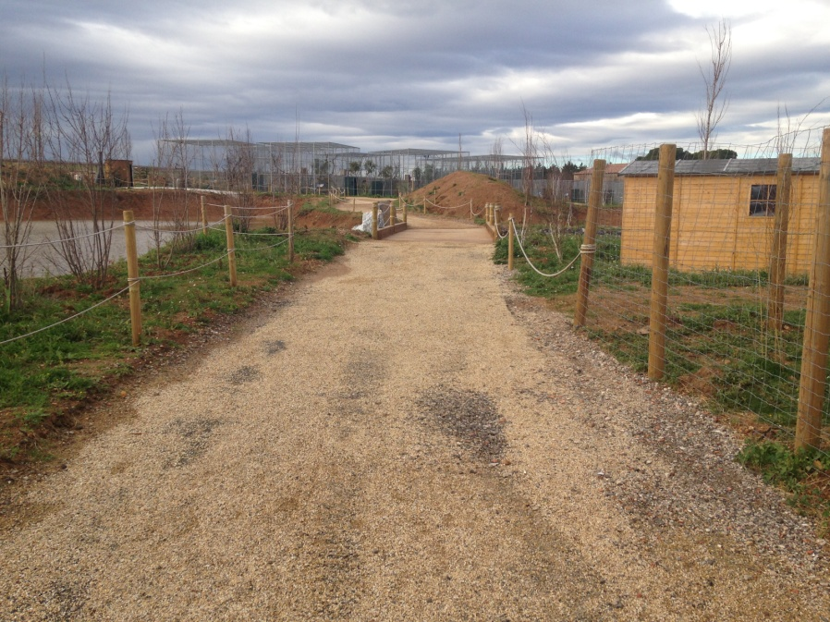

INTRODUCTION – Profile of the job site
Meteorological Profile

Slide 4

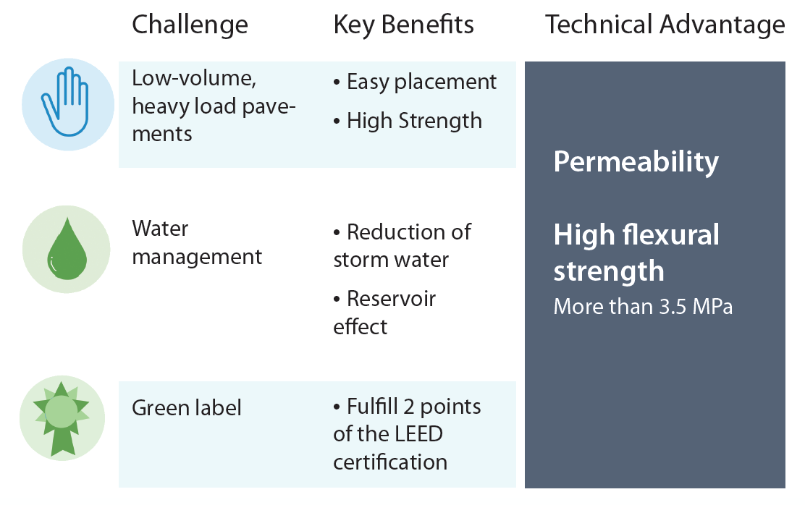
PERVIA – Permeable Concrete for Cost Effective Water Management

Slide 5
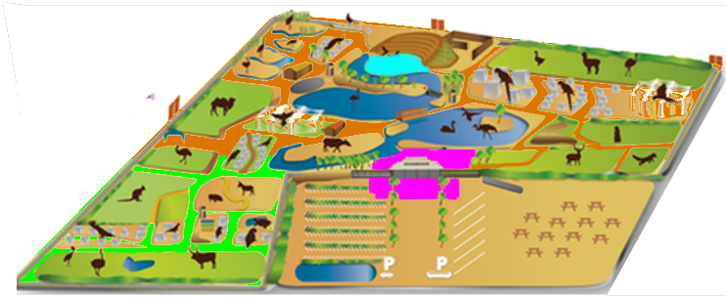
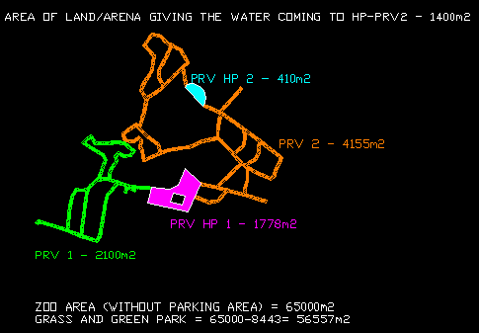
OUR PROPOSAL – Definition of 4 different zones
Due to the natural slope, we propose to drain and direct all the water flow from the alleys to the main entrance area, where a specific drainage will be design.
The main alleys (PRV1 and PRV2) will be built with a single layer of 15 cm of Decorative Pervia Concrete on top of the existing pavement. Edges will be covered by geotextile and soil.
The area of the entrance and the handicap parking (PRV HP1), where the water is directed, will be a combination of a High Performance Pervia Concrete (15 cm) and a specific Sub-base
In the case of the area in front of the Arena (PRV HP2) the pavement will be designed to ensure a complete drainage using High Performance Pervia Concrete (15 cm) and also a permable sub-base
Calculated volume
Decorative
PRV1 : 2100 m²
PRV2 : 4155 m²
High Performance
PRVHP1 : 1778 m²
PRVHP2 : 410 m²
Drawn map of Zoo
6255m² - 938 m³
2188m² - 328 m³
AutoCAD representation of the pathway of the Zoo
* Details slide 7

Slide 6
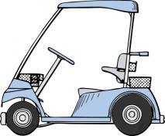



STRUCTURAL DESIGN – Decorative and High Performance
PRV 1 - Decorative
PRV 2 - Decorative
HP PRV 1 – High Performance
HP PRV 2 – High Perfiormance
Structural
Design
Decorative
Up to 3.5t vehicules
Drainage using Asphalt
Aesthetic finish
High Performance
Up to 12t vehicules
Optimised Pervia Sub-base
High structural resistance
Tonnes
Tonnes

Slide 7


DIFFERENT APPROACHES – Economical or Ecological
From the initial proposal, two main approaches can be envisaged depending if focus is given to economical aspects or to ecological considerations. The economical solution is an evolutive proposal, where green recycling of water can be implemented.
2
1‘
Natural drainage of water in the soil
Excavation of asphalt
Permeable sub-base
(8000 m²)
Collection of water and recycling for Zoo usage
Same features plus:
Integral system to re-use
the water for gardening/WC
Ecological
1
Collection of water and evacuation in main sewage
Use of current asphalt
Pervia sub-base (2000 m²):
structural improvement
Economical

Slide 8
CEMEX PRIORITY PROPOSAL – Economical approach
The Option 1 is to our opinion the best approach, making use of the current asphalt pavement that can be re-used as sub-base. The excavation would be extremely reduced and the re-opening of the alleys would be faster.
2
1‘
Natural drainage of water in the soil
Excavation of asphalt
Permeable sub-base
(8000 m²)
Collection of water and recycling for Zoo usage
Same features plus:
Integral system to re-use
the water for gardening/WC
Ecological
1
Collection of water and evacuation in main sewage
Use of current asphalt
Pervia sub-base (2000 m²):
structural improvement
Fastest re-opening of alleys
Reduced needs for excavation
Optimized structural design
Evolutive solution
Economical

Slide 9
ECONOMICAL PROPOSAL – Schematic Sections
Zones | Base (thickness) | Pervia (thickness) | Hydrological Design
PRV1/2 | Actual⁽¹⁾ | Decorative (15 cm)
HP PRV 1 | Pervia Sub-base (25 cm) | High Performance (15 cm)
HP PRV2 | Gravel (35 cm) | High Performance (15 cm)
 Material needed………………..
PRV 1 - Decorative
PRV 2 - Decorative
HP PRV 1 – High Performance
HP PRV 2 – High Perfiormance

Slide 10
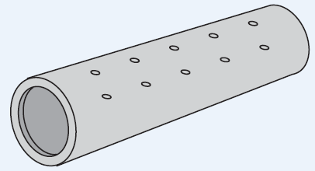
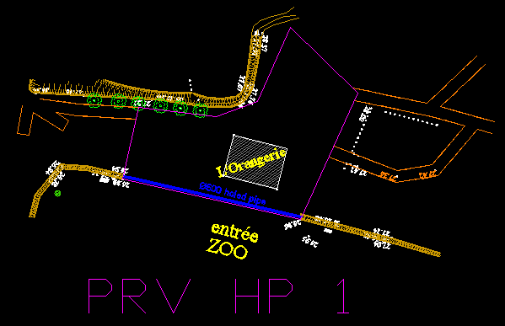
DRAINAGE SYSTEM – Using the existing sewage
A D=600mm – 60 m length holed pipes (only on top half circle) will be placed in the lowest part of the HP PRV 1 zone and covered by mean of geotextile in order to prevent clogging of the holes.
Main Entrance
Water is drained entirely to the Main Entrance
Area where a pipe will ensure the evacuation
To the existing sewage.

Slide 11
EVOLUTION OF OPTION 1 – Recycling of stormwater
The storwater collected at the main entrance by the pipe system can be stored and re-used after adequate treatment for gardening and non-sanitary usages.
2
1‘
Natural drainage of water in the soil
Excavation of asphalt
Permeable sub-base
(8000 m²)
Collection of water and recycling for Zoo usage
Same features plus:
Integral system to re-use
the water for gardening/WC
Ecological
1
Collection of water and evacuation in main sewage
Use of current asphalt
Pervia sub-base (2000 m²):
structural improvement
Evolution possible
Recycling of stormwater
Cost reduction sanitary water
Ecological approach
Economical

Slide 12
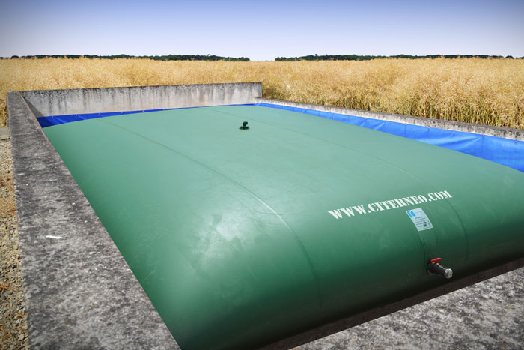
WATER CITERN – Soft containers to store and reuse water
High volume (ca. 5000 m³) container can be easily found and can be installer to store water during rainy season. The recycled water can then be used during the dry season.

Slide 13
ECOLOGICAL APPROACH – Natural Drainage
The second would consist in a complete excavation of the asphalt pavement, and to design the alleys and pavements to allow a natural drainage of the stormwater in the soil. Although this option is attractive, it would generates more waste materials and would necessitate higher concrete volumes.
2
1‘
Natural drainage of water in the soil
Excavation of asphalt
Permeable sub-base
(8000 m²)
Collection of water and recycling for Zoo usage
Same features plus:
Integral system to re-use
the water for gardening/WC
Ecological
1
Collection of water and evacuation in main sewage
Use of current asphalt
Pervia sub-base (2000 m²):
structural improvement
Natural drainage of water
Optimized sub-base design
No need to level borders
Economical

Slide 14
ECOLOGICAL PROPOSAL – Schematic Sections
Zones | Base (thickness) | Pervia (thickness)
PRV1/2 | Pervia Sub-base (25 cm) | Decorative (15 cm)
PRV HP1 | Pervia Sub-base (25 cm) | High Performance (15 cm)
PRV HP2 | Gravel (granulometry TBD) (35 cm) | High Performance (15 cm)
 Material needed……………..
PRV 1 - Decorative
PRV 2 - Decorative
HP PRV 1 – High Performance
HP PRV 2 – High Perfiormance

Slide 15
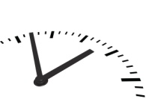


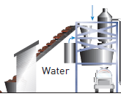
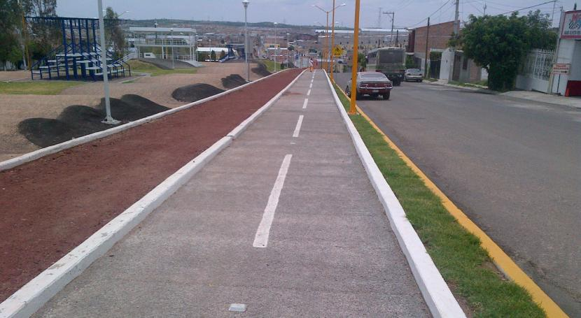
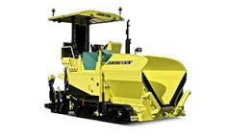


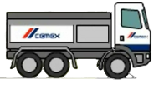

Pervious Concrete vs. Asphalt
Value Chain
1
2
3
4
5
Raw materials
Production
Transportation
Placing
Jobsite

Slide 16
Pervious Concrete vs. Asphalt
Value Chain
1
2
3
4
5
Raw materials
Production
Transportation
Delivery
Jobsite
  Gravel / Sand
Selection of local source of aggregates
  Easy to produce and eventually reproduce in the future
  Choice of granulometry possible to change texture
Admixtures
In house technology to manage range of performance
  Decorative
  High performance
Colorant
Final aspect and color can be tailor design to the wishes of the customer

Slide 17
Pervious Concrete vs. Asphalt
Value Chain
1
2
3
4
5
Raw materials
Production
Transportation
Placing
Jobsite
Asset
Use local production equipment
  Ready-Mix Plant close to the jobsite to assure logistic optimization
Quality concrete
Mix design methodology to guaranty Strength and Permeability

Slide 18

Pervious Concrete vs. Asphalt
Value Chain
1
2
3
4
5
Raw materials
Production
Transportation
Placing
Jobsite
Transportation
Use existing Ready-Mix trucks
Extended workability – up to 3hours if needed

Slide 19
Pervious Concrete vs. Asphalt
Value Chain
1
2
3
4
5
Raw materials
Production
Transportation
Placing
Jobsite
Placing
Use existing Paver / Roller equipment
Improve equipment performance and robustness (better Industrialization)
Large choice of tools depending on type of concrete
Can be done manually
Placing / Compaction
Techniques

Slide 20
Pervious Concrete vs. Asphalt
Value Chain
1
2
3
4
5
Raw materials
Production
Transportation
Delivery
Jobsite
Jobsite
Better finishing: choice of colors
Better strength and durability
Faster placement and re-opening of jobsite (24hours)
  Minimize lost of profits
Benefits
Efficient solution to collect and manage Rainwater
  Reduction of storm water runoffs
  Reservoir effect: recycling of water possible
Easy placement and finishing
Green Label – LEED certification

Slide 21
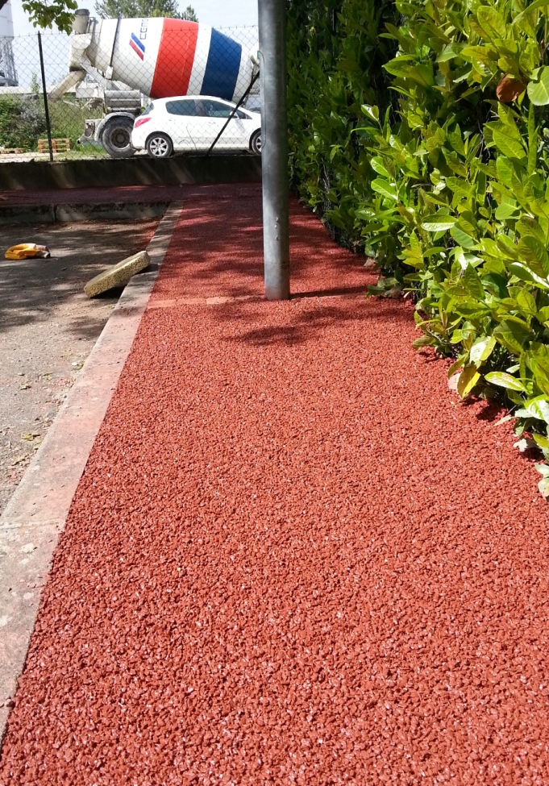
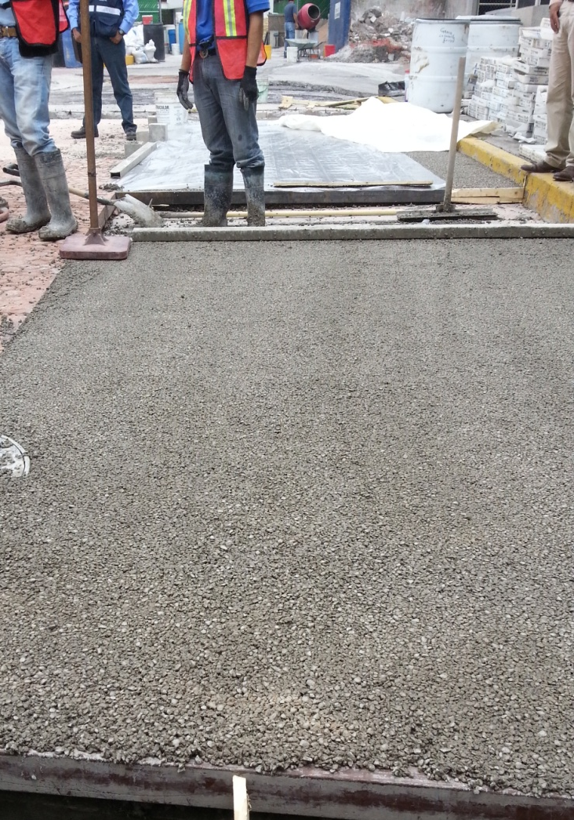
EXAMPLES OF PERVIOUS CONCRETE – Decorative and High Perfomance
Decorative Concrete – CX France
Toulouse – April 2014
HP Pervious – CX Mexico
Mexico City – May 2014

Slide 22
BACK UPs

Slide 23
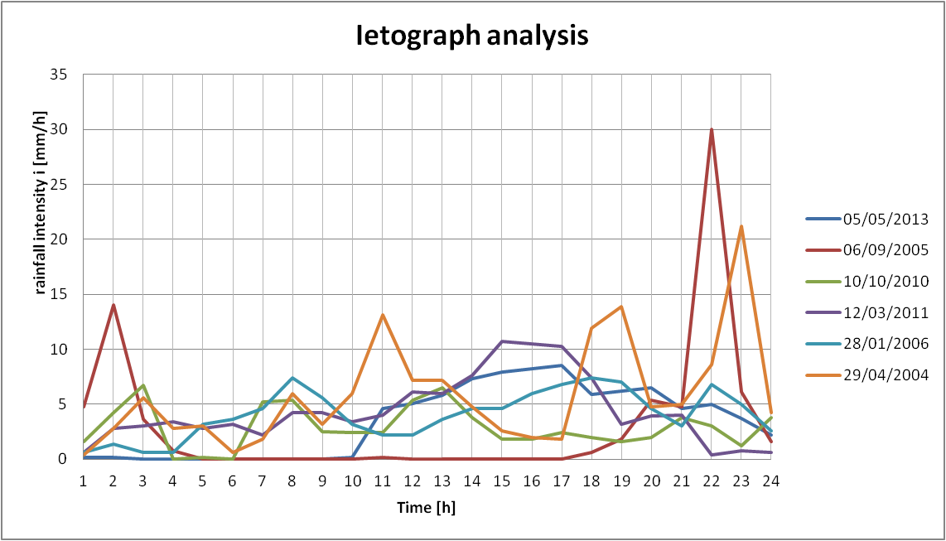
OUR PROPOSAL – Hydrological design
The design of each zone was defined based on the statistical analysis of the rain profile from 2004 to 2013 from the data coming from the Pezenas’s meteorological station. The 6 worst 24-hours rains are shown in the graph below:
In order to build the hydrological design for the Zoo, the worst rain period from the last 10 years was used (April 19, 2004 - 140.4 mm/24 h)
The return period was taken, according to safety reasons, at 10 years

Slide 24
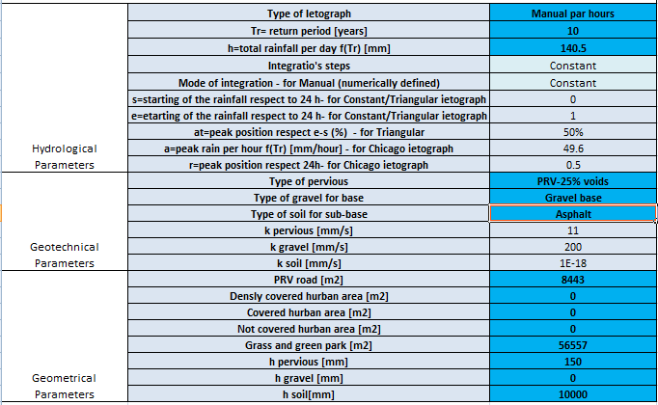
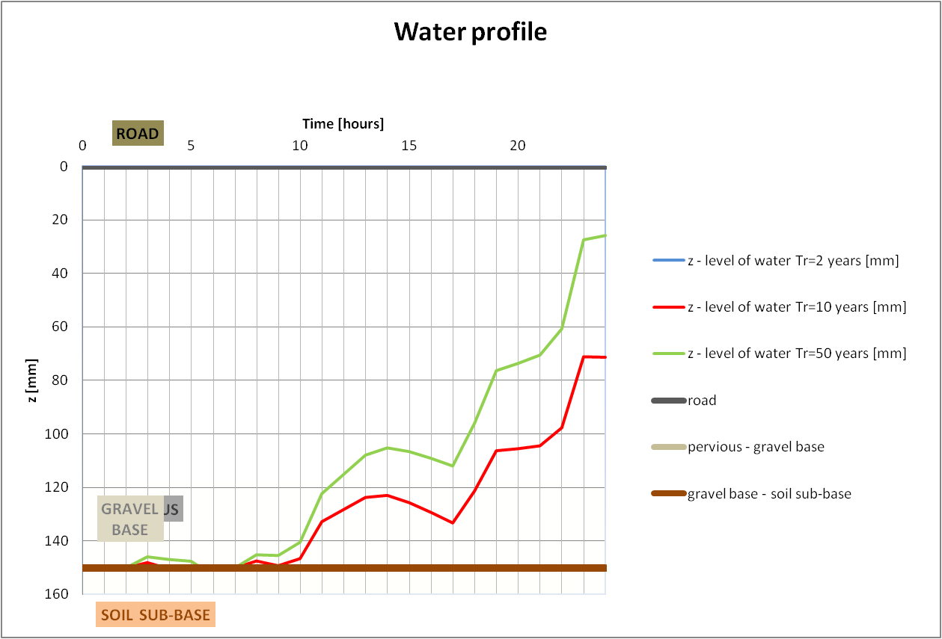
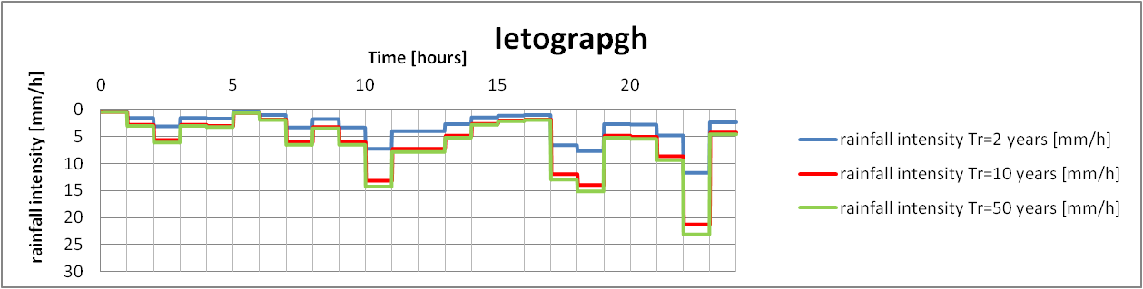
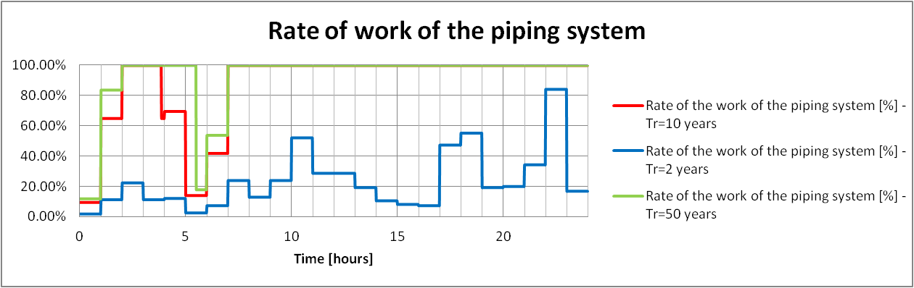
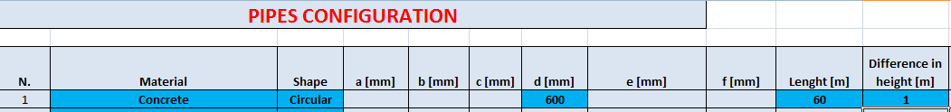
HYDRAULICAL ANALYSIS – Overall analysis (PRV1 and PRV2)
A first overall analysis of the site was done considering a overall thickness of pervious of 15 cm and no presence of gravel (in order to be in the safety side). For safety and to better simulate the presence of the 1-cm-layer of asphalt, the soil was considered impermeable (k=1exp-18 mm/s)

Slide 25
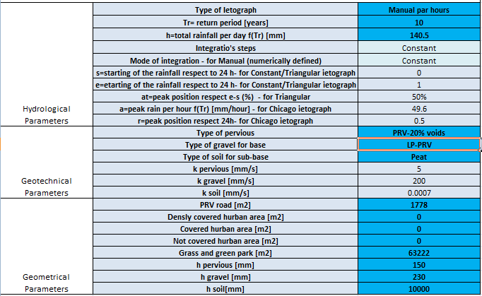
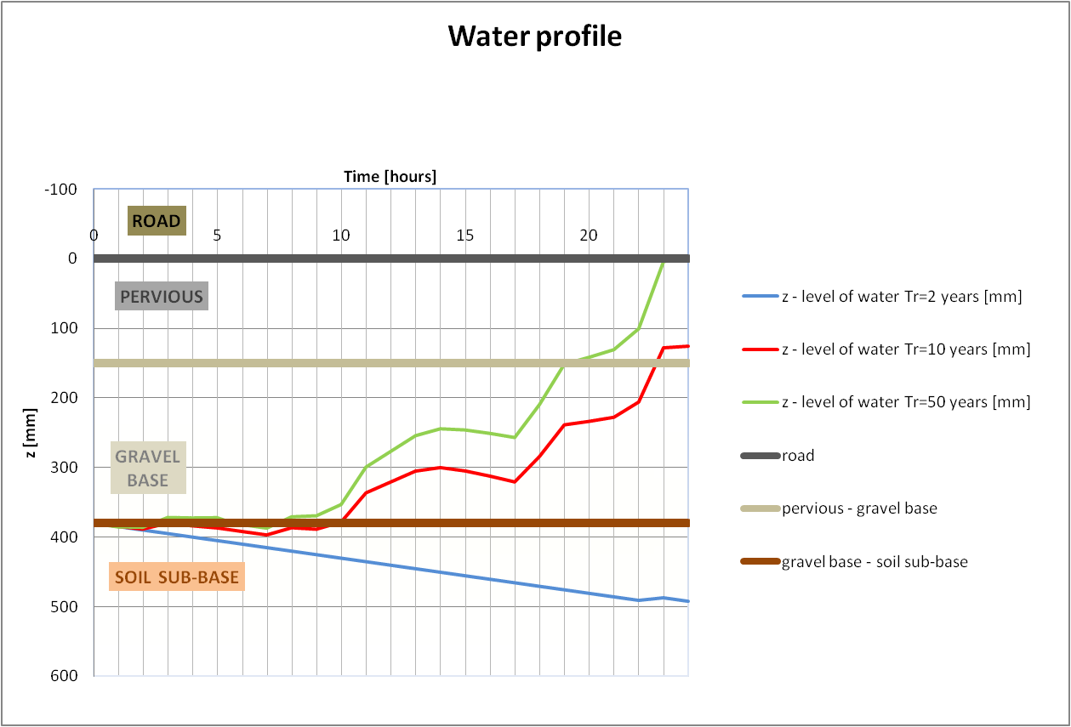
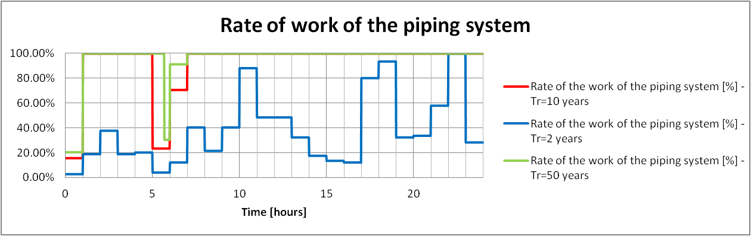
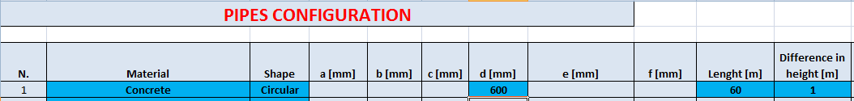
HYDRAULICAL ANALYSIS – HP PRV 1
In this analysis we wanted to simulate that all the water in the zoo is dropped in the entrance zone (as happened in the last rain event). Layer of 15 cm of HP-PRV and 23 cm of LP-PRV where considered in the design. For safety the permeability of the soil was considered to be low (k=0.007 mm/s).

Slide 26
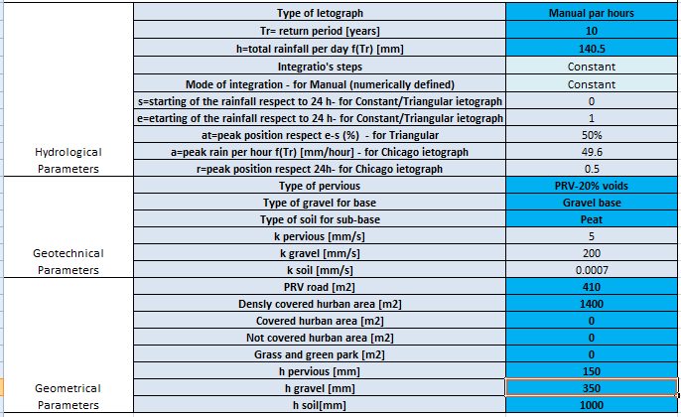
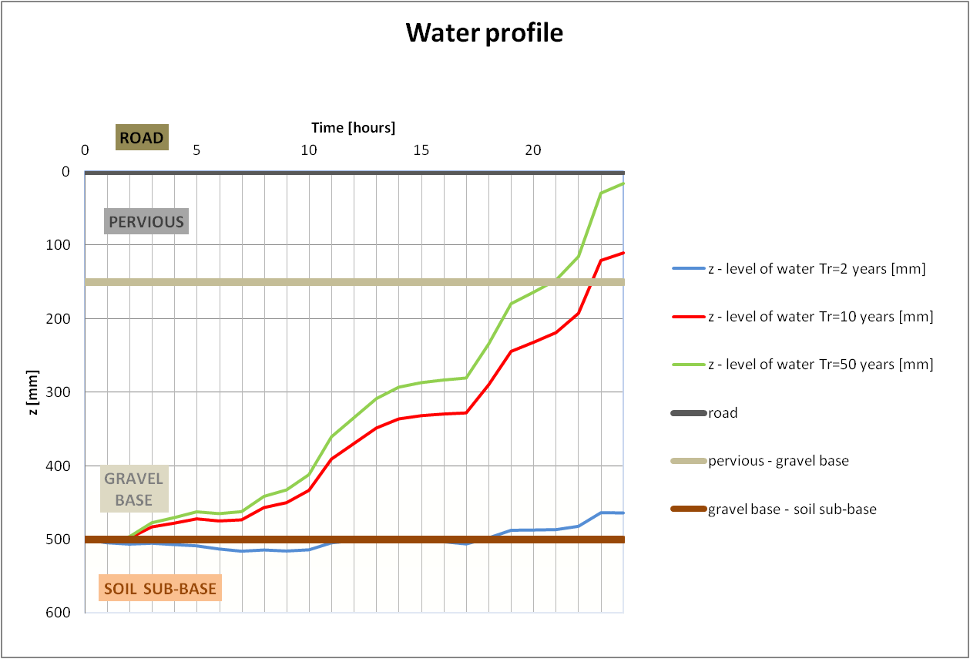

HYDRAULICAL ANALYSIS – HP PRV 2
In this analysis we wanted to simulate that all the water of the arena (fully impermeable) is going to part in front of it. Layer of 15 cm of HP-PRV and 35 cm of gravel where considered in the design. For safety the soil was considered slightly permeable (k=0.0007 mm/s). No piping system is adopted for this zone.

Slide 27
MATERIAL NEEDED – Economical Proposal
 | HP PRV 1 | HP PRV 2 | PRV 1 | PRV 2 |  | TOTAL
Area [m2] | 1778 | 410 | 2100 | 4155
Equivalent Linear length [m] | - | - | 600 | 1188
Excavation [mm] | 380 | 500 | - | -
Geotextile on the total surface [y/n] | y | y | n | n
Gravel thickness [mm] | - | 350 | - | -
LP PRV thickness [mm] | 250 | - | - | -
HP PRV thickness [mm] | 150 | 150 | - | -
Aestetic PRV thickness [mm] | - | - | 150 | 150
Concrete holed pipe Din600 Dout704 [m] | 60 | - | - | -
External surface of the pipe [m2] | 132.7009 | - | - | -
Excavation volume [m3] | 675.64 | 205 | - | - |  | 880.6
Plastic foil [m2] | - | 70 | - | - |  | 70.0
Geotextile on the surface [m2] | 1778 | 410 | - | - |  | 2188.0
Geotextile on the edges [m2] | - | - | 600 | 1188 |  | 1788.0
Geotextile on the pipes [m2] | 132.7009 | - | - | - |  | 132.7
Gravel volume [m3] | - | 143.5 | - | - |  | 143.5
LP PRV volume [m3] | 444.5 | - | - | - |  | 408.9
HP PRV volume [m3] | 266.7 | 61.5 | - | - |  | 328.2
Aestetic PRV volume [m3] | - | - | 315 | 623.25 |  | 938.3
Material | Unit | Quantity
Gravel | m3 | 143.5
LP PRV | m3 | 444.5
HP PRV | m3 | 328.2
Aestetic PRV | m3 | 938.3
Plastic foil | m2 | 70.0
Geotextile | m2 | 4108.7
Excavation | m3 | 880.6
Concrete holed pipe Din600 Dout704 | m | 60.0

Slide 28
MATERIAL NEEDED – Ecological Proposal
 | HP PRV 1 | HP PRV 2 | PRV 1 | PRV 2 |  | TOTAL
Area [m2] | 1778 | 410 | 2100 | 4155
Equivalent Linear length [m] | - | - | 600 | 1188
Excavation [mm] | 380 | 500 | 380 | 380
Geotextile on the total surface [y/n] | y | y | y | y
Gravel thickness [mm] | - | 350 | - | -
LP PRV thickness [mm] | 250 | - | 250 | 250
HP PRV thickness [mm] | 150 | 150 | - | -
Aestetic PRV thickness [mm] | - | - | 150 | 150
Excavation volume [m3] | 675.64 | 205 | 798 | 1578.9 |  | 3257
Plastic foil [m2] | - | 70 | - | - |  | 70.0
Geotextile on the surface [m2] | 1778 | 410 | 2100 | 4155 |  | 8843
Geotextile on the edges [m2] | - | - | - | - |  | 0
Geotextile on the pipes [m2] | - | - | - | - |  | 0
Gravel volume [m3] | - | 143.5 | - | - |  | 143.5
LP PRV volume [m3] | 444.5 | - | 525 | 1038.75 |  | 2008
HP PRV volume [m3] | 266.7 | 61.5 | - | - |  | 328.2
Aestetic PRV volume [m3] | - | - | 315 | 623.25 |  | 938.3
Material | Unit | Quantity
Gravel | m3 | 143.5
LP PRV | m3 | 2008
HP PRV | m3 | 328.2
Aestetic PRV | m3 | 938.3
Plastic foil | m2 | 70.0
Geotextile | m2 | ¨8843
Excavation | m3 | 3257

Slide 29
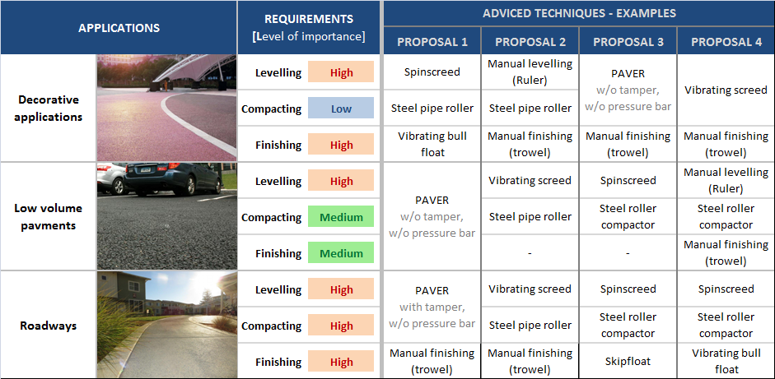
PLACING / COMPACTION TECHNIQUES
Many methods available to place pervious concrete
Depending on the application, importance of leveling, compaction and finishing can vary.
The table below summarizes requirements of each application and provides guidance to place the pervious concrete accordingly.

Slide 30
STRUCTURAL ANALYSIS – Validation of our proposal
Structural verifications were carried out for the following loads:
12 Tonnes and 4-wheels vehicle in the entrance, where HP PRV is designed
Golf Electric Car and Ambulance (3.5 Tonnes) in the path , where Decorative PRV is designed
HP PERVIA |  |  | DECORATIVE PERVIA
Indirect Tensile Splitting Strength [Mpa] | 3.6 |  | Indirect Tensile Splitting Strength [Mpa] | 2.7
Flexural strength [Mpa] | 4 |  | Flexural strength [Mpa] | 3
alfa cc | 0.85 |  | alfa cc | 0.85
gamma material | 1.5 |  | gamma material | 1.5
max flexural strength achievable | 2.27 |  | max flexural strength achievable | 1.70
Q real [kN] | 60 |  | Q real [kN] | 8.75
gamma load | 1.6 |  | gamma load | 1.6
Q design [kN] | 96 |  | Q design [kN] | 14
a [mm] | 500 |  | a [mm] | 350
b[mm] | 500 |  | b[mm] | 500
s (thickness) [mm] | 150 |  | s (thickness) [mm] | 150
E [Mpa] | 16000 |  | E [Mpa] | 16000
Poisson's ratio | 0.2 |  | Poisson's ratio | 0.2
K (modulus of soil) [Mpa/mm] | 0.2 |  | K (modulus of soil) [Mpa/mm] | 0.05
a (equivalent radius of the loaded area) [mm] | 282.09 |  | a (equivalent radius of the loaded area) [mm] | 236.02
D (=Et^3/(12(1-poisson^2))) | 4687500000 |  | D (=Et^3/(12(1-poisson^2))) | 4687500000
l=(D/k)^0.25 | 391.27 |  | l=(D/k)^0.25 | 553.34
Stress (load in the center) [Mpa] | 2.21 |  | Stress (load in the center) [Mpa] | 0.50
Stress (load on the border) [Mpa] | 1.13 |  | Stress (load on the border) [Mpa] | 0.33
Stress (load on the corner) [Mpa] | -0.15 |  | Stress (load on the corner) [Mpa] | 0.49

Slide 31
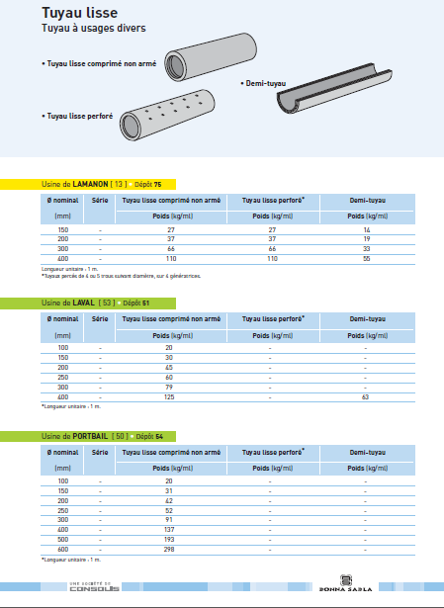

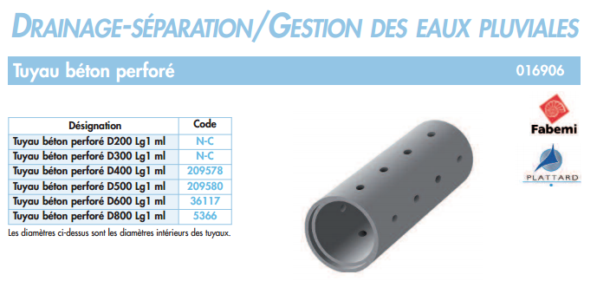

ADDITIONAL DRAINAGE SYSTEM – Example of Suppliers

