Slide 2
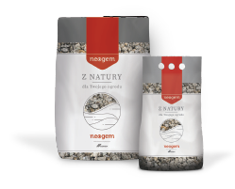
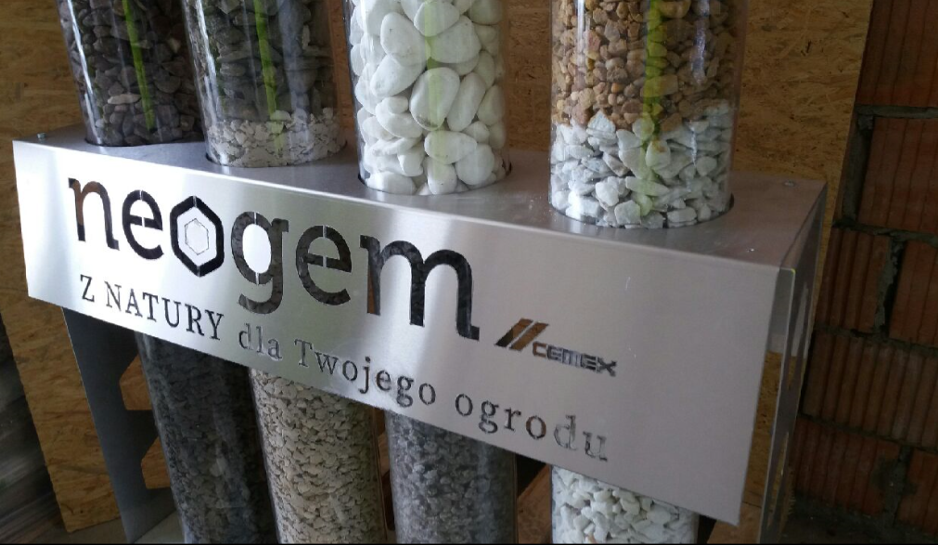


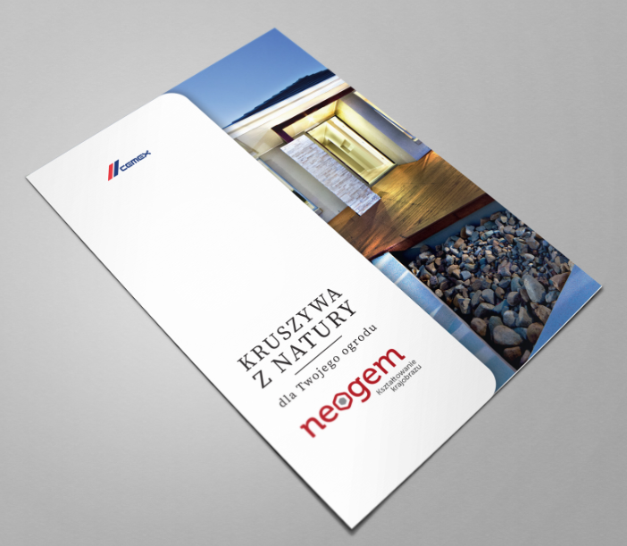



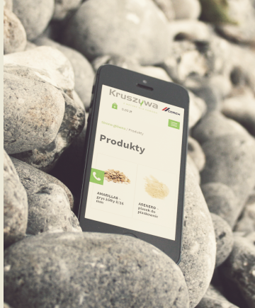
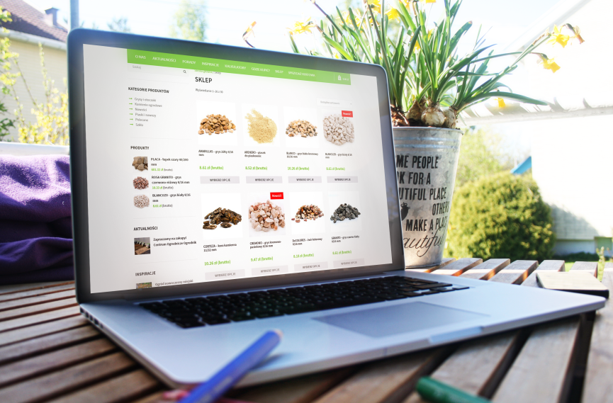
neogem decorative AGG
Garden & Gravion for green roofs
CEMEX Operation: Dolomie Quarry, Gravel Pit, Trading, Poland, Greece, Italy
PSD + GC: 4/8 mm, 8/16 mm, 25/40 mm, 40/80 mm and others
Type of Application: Landscaping, green roofs, gardens, path
band around the house, Interior decorative element
Unique Selling Proposition: wide product portfolio, a multitude of colors and dimensions, flexible delivery forms, small packages, Big Bags and loose, marketing support for clients, franchise program and flexible forms of settlements
Technical Requirements and Specs for production: : purity of aggregates, there are no requirements as to the property, the visual aspect is the most important. Hopper with weight for big bags,
an automatic or semi-automatic plant for packing small bags or outosoring services
Typical Clients: garden centers, developers, green roof contractors, DIY’s, dicount stores, building warehauses, Indyviduals, precast producers, camplanies dealing with urban greenery
FOB selling price VS. Av. CVMC Family FOB Price:
  Garden: 136 USD/t (Δ IVC 130 USD/t) VS. 5,51 USD/t.
  Gravion: 16,30 USD/t (Δ IVC 10.78 USD/t) vs. 11,92 USD/t
Estimated Market Size / Vol. garden 210 000 tons, Gravion for green roofs- TBD
3

