Slide 2

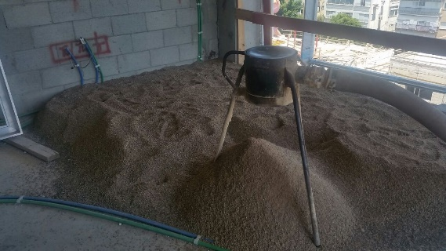
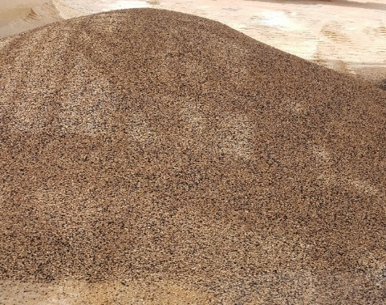
Atomix Neogem
CEMEX Operation/Type of Mine: Lime Quarry (Modiim Israel)
Particle Size Distribution + Grading Curve: Agg 0 – 5 mm + rubber granulate 1-4 mm
neogem Category + Type of Application: Industrial, Builders
Unique Selling Proposition: Acoustic base for tiles – provides acoustic insulation without instalation of regular acoustic layer.
Technical Requirements and Specs for production: Spatial weight – 1250-1350 kg. Sound reduction
Additional Comment: Passed ISO10140-3 sound reduction requirement protocol.
Typical Clients: Apartments builders
How did you find your point of contact: Proffecional exhibitions
FOB selling price VS. Av. OCF : 28$/t Vs 5$/t
Estimated Market Size / Vol. 6000t/Annualy
4

